Slide 1
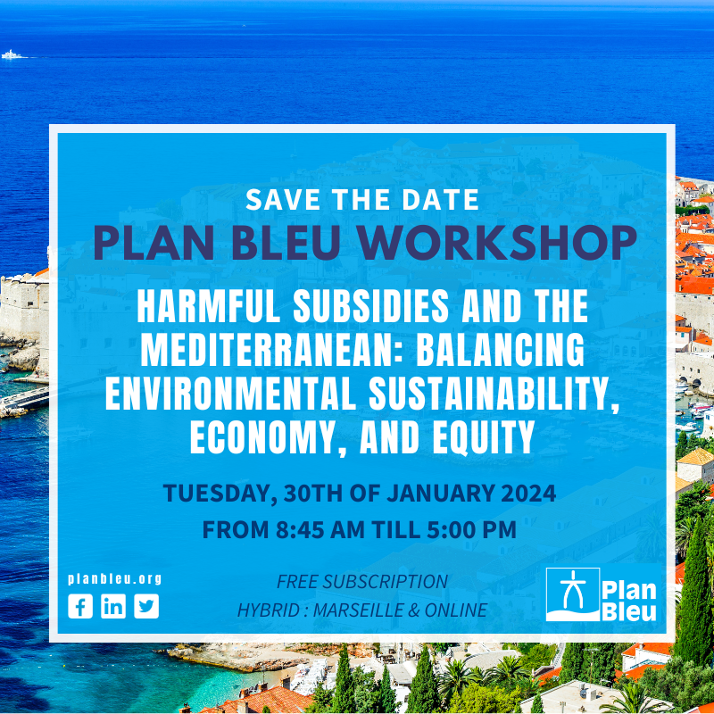

Slide 2
Tax Incentives and Energy Transition from a Legal Point of View: Analysis of Best Practices Adapted to the Decarbonisation of the Mediterranean Region
Merve Ergun
Attorney at Law, Izmir Bar Association, Türkiye
PhD Candidate, University of Camerino, Italy
merve.ergun@unicam.it/att.mergun@gmail.com

Slide 3
Content:
The best mix of fiscal policies/ incentive schemes supported for RE
Decarbonisation of Energy Industry→ Electricty Supply Industry
(ESI) in particular →electricity is the main energy used for not only industrial production but also for the heating and transportation sectors.
1-) The EU State Aid Rules
Legal Basis, The State Aid Concept, Environmental Aid
2-) Case Studies
3-) Results
4-) Recommendations for the Mediterranean Region
Worst Practices
Best Practices

Slide 4
1. The EU State Aid Rules
Energy & Taxation / states’ desire to control and regulate energy taxation
(EU Level problems)
Negative integration →Positive integration
State Aid Action Plan (SAAP) :
‘Refined Economic Approach’
‘Less and Better Targeted Aid’
The General Block Exemption Regulations
Picture: https://www.government.nl/latest/news/2021/11/11/why-strong-eu-competition-and-state-aid-rules-matter

Slide 5
Legal Basis
TFEU Articles 107-108
TFEU Article 4(1): ’ The Union shall share competence with the Member States where the Treaties confer on it a competence which does not relate to the areas referred to in Articles 3 and 6.’
TFEU Article 3(1)b : ‘The Union shall have exclusive competence in the following areas:…
(b) the establishing of the competition rules necessary for the functioning of the internal market’
TFEU Article 5(1): ‘The limits of Union competences are governed by the principle of conferral. The use of Union competences is governed by the principles of subsidiarity and proportionality.’
Picture: https://www.pubaffairsbruxelles.eu/eu-institution-news/european-commission-reaffirms-the-primacy-of-eu-law/

Slide 6
TFEU Article 107 (ex Article 87 TEC)
1. Save as otherwise provided in the Treaties, any aid granted by a Member State or through State resources in any form whatsoever which distorts or threatens to distort competition by favouring certain undertakings or the production of certain goods shall, in so far as it affects trade between Member States, be incompatible with the internal market.
2. The following shall be compatible with the internal market:
(a) aid having a social character, granted to individual consumers, provided that such aid is granted without discrimination related to the origin of the products concerned;
(b) aid to make good the damage caused by natural disasters or exceptional occurrences;
(c) aid granted to the economy of certain areas of the Federal Republic of Germany affected by the division of Germany, in so far as such aid is required in order to compensate for the economic disadvantages caused by that division. Five years after the entry into force of the Treaty of Lisbon, the Council, acting on a proposal from the Commission, may adopt a decision repealing this point.
3. The following may be considered to be compatible with the internal market:
(a) aid to promote the economic development of areas where the standard of living is abnormally low or where there is serious underemployment, and of the regions referred to in Article 349, in view of their structural, economic and social situation;
(b) aid to promote the execution of an important project of common European interest or to remedy a serious disturbance in the economy of a Member State;
(c) aid to facilitate the development of certain economic activities or of certain economic areas, where such aid does not adversely affect trading conditions to an extent contrary to the common interest;
(d) aid to promote culture and heritage conservation where such aid does not affect trading conditions and competition in the Union to an extent that is contrary to the common interest;
(e) such other categories of aid as may be specified by decision of the Council on a proposal from the Commission.

Slide 7
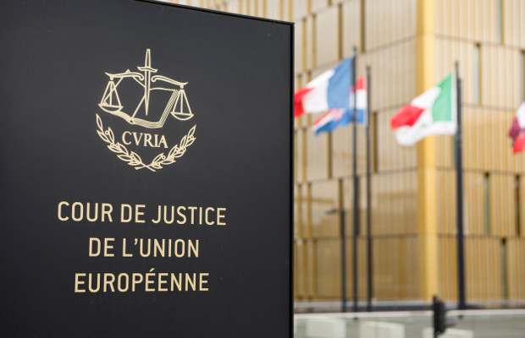
The State Aid Concept
TFEU Article 107
the four requirements/ criteria :
-transfer of state sources
-advantage for the undertaking
-selectivity
-distortion to competition and effect on the trade between Member States
The CJEU’s jurisprudence regarding state aid involves the cross-examination of some key notions, such as: advantage, selectivity, and discrimination.
Picture: https://www.worldipreview.com/contributed-article/upc-the-role-of-the-cjeu

Slide 8
Environmental Aid
The Article 191(2) of the TFEU:
‘Union policy on the environment shall aim at a high level of protection taking into account the diversity of situations in the various regions of the Union. It shall be based on the precautionary principle and on the principles that preventive action should be taken, that environmental damage should as a priority be rectified at source and that the polluter should pay. In this context, harmonisation measures answering environmental protection requirements shall include, where appropriate, a safeguard clause allowing Member States to take provisional measures, for non-economic environmental reasons, subject to a procedure of inspection by the Union.’
The legal basis of the environmental taxes → the Polluter Pays Principle
The Community Guidelines on state aid for environmental protection ( not applied nuclear power reactors )
Picture: https://www.interregeurope.eu/policy-learning-platform/news/new-environmental-state-aid-guidelines

Slide 9
2. Case Studies
1-) State Aid N 707/2002, The Netherlands MEP ( Stimulating renewable energy) (2003) O.J. C148/11
State Aid N 708/2002, The Netherlands MEP ( Stimulating combined heat and power production
(CHP)) (2003), O.J. C148/11.
2-) Case T-109/01, Fleuren Compost/ Commission, Judgement of 14 January 2004, ECR II-127, 54.
3-) Case t-176/01, Ferriere Nord/Commission, Judgement of 18 November 2004, ECR II-3931, 151.
RE Support policies
Feed-in tariff (FIT) schemes, Renewable Portfolio Standards (RPS) Schemes and Tradable Green Certificate (TGC) Schemes
When and what kind of environmental measures can be regarded as state aid under Article 107(1) of the TFEU ?
According to the CJEU:
compulsory contributions imposed upon electricity consumers / e.g. the MEP introduced by the Netherlands
Social, economic, environmental and health objectives, own their own, are not sufficient to escape from the application of Article 87 EC.
Justification for an aid : 107/3 TFEU
New Guidelines & Commission → the balancing test (positive- negative effects of the environmental aid)
The projects-partial environmental objective

Slide 10
3.Results
FIT schemes ( Denmark, Germany, Spain, the UK)
-simple schemes
-the grid access responsibility
-generation costs may increase→ Future rates
-Ambitious FIT-based programmes ( short term RE share increase / long term rate increase)
-TGC programme ( the UK)
-RPS programmes ( the State of Texas)
-responsibility/ risk management→ RE Provider

Slide 11
4. Recommendations
RE→ Energy Security
RE Transition→ costs R&D
Fiscal policies should be designed by considering:
the notion of incentive effect (with/without aid)
proportionality ( less aid/ not same result)
Introducing new taxes/ incentive mechanisms simultaneously
RECs ( energy conscious)
Best Practices:
Pigouvian Approach→ Effective carbon taxes ( for carbon intensive industries)
FIT Schemes→ for RE Electricity
Worst Practices:
Complex aid or incentive mechanisms→ SMEs(-)
Complex Carbon Trading Mechanisms → beneficial for large companies (+)
Subsidies provided for the hazardous energy generation methods

Slide 12
Best Practices for the Mediterranean Region
Best Practices | WHY? | HOW?
Pigouvian Approach/ while designing new Policy Tools-instruments | - externalities/ + externalities | Introducing effective carbon taxes
Particular attention→ Wind/ Solar Energy | Mediterrenean Region | Barcelona Convention- off shore protocol→the off-shore wind farms
No subsidies for the environmentally hazardous methods | to speed up energy transition | no/limited subsidies introduction of new incentive mechanisms for RE.
FiT Schemes for Renewable Electricity | Simple Schemes Rapid deployments Responsibility (reduces risks from the renewable generator ) | Guidelines on State aid for climate, environmental protection and energy The CJEU Case Law The Commission Practice
refraining from conventional medhods | TFEU Article 191 Barcelona Convention | the strict application of the precautionary principle

Slide 13
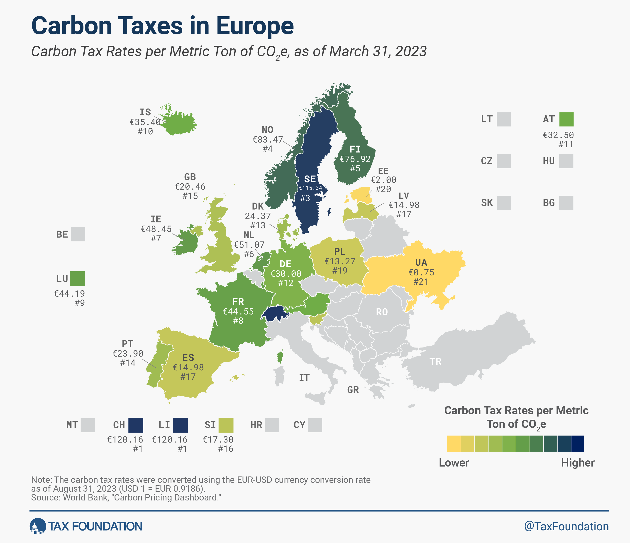

Slide 14
THANK YOU!
References:
Ben J. M. Terra, Peter J. Wattel, European Tax Law (Fifth Edition,Kluwer Law International, 2008)
Kelyn Bacon, European Community Law of State Aid ( 2009, Oxford University Press Inc, New York)
Leigh Hancher, Tom Ottervanger, Pıet Jan Slot, EU Stade Aids (Sweet & Maxwell-Thomson Reuters,4th edn, 2012)
M. Villar Ezcurra: State Aid Law and Business Taxation (Springer, Vol:6, Berlin Heidelberg 2016)
Rene Barents, Directory of EC Case Law on State Aids ( Kluwer International, Aalpen aan den Rijn, 2008)
R.S.R.F. Mathijsen and P. Dyrberg, Mathijsen’s Guide to European Union Law ( Sweet& Maxwell, Thomson Reuters,11th edn, 2013)
Isabelle Richelle, Wolfgang Schon, Edoardo Traversa, ‘State Aid Law and Business Taxation’ (Springer, Berlin& Heidelberg, 2016)
Nicola Saccardo, Tsax Implications of Brexit, (Bloomsburry Professional, 1st edn, 2021)
David M. Newbery, ‘Towards a green energy economy? The EU Energy Union’s transition to a low-carbon zero subsidy electricity system – Lessons from the UK’s Electricity Market Reform’ Applied EnergyEnergy Policy Research Group (EPRG), University of Cambridge, Sidgwick Ave., Cambridge CB3 9DE, UK.
Green, Richard and Adonis Yatchew, ‘Support Schemes For Renewable Energy: An Economic Analysis’ Economics Of Energy & Environmental Policy, Vol. 1, No. 2, 2012
Juan Jorge Piernas López, ‘The Evolving Nature of the Notion of Aid under EU Law’ European State Aid Law Quarterly , Vol. 15, No. 3 (2016), 400.
Josep Lloret, Paul Wawrzynkowski, Carlos Dominguez-Carrió, Rafael Sardá, Climent Molins, Josep Maria Gili, Ana Sabatés, Josep Vila-Subirós, Laura Garcia, Jordi Solé, Elisa Berdalet, Antonio Turiel, Alberto Olivares, Floating offshore wind farms in Mediterranean marine protected areas: a cautionary tale, ICES Journal of Marine Science, 2023;, fsad131, https://doi.org/10.1093/icesjms/fsad131
Zubeyde Senturk Ulucak and Ali Gokhan Yucel, ‘Can renewable energy be used as an effective tool in the decarbonization of the Mediterranean region: fresh evidence under cross-sectional dependence’ Environmental Science and Pollution Research (2021) 28:52082–52092 https://doi.org/10.1007/s11356-021-14350-2
Michael Blauberger, ‘From Negative to Positive Integration. European State Aid Control through Soft and Hard Law’EUSA Eleventh Biennial International Conference, 23-25 April 2009
IIDS: SDG Knowledge Hub < https://sdg.iisd.org/commentary/guest-articles/spring-boarding-from-ocean-conservation-to-sustainable-development-the-barcelona-convention/> accessed 6 October 2023.
Communication from the Commission – Guidelines on State aid for climate, environmental protection and energy 2022 (OJ C 80, 18.2.2022, pp. 1–89)
EUR Lex: Summaries of EU Legislation < https://eur-lex.europa.eu/EN/legal-content/summary/2022-guidelines-on-state-aid-for-climate-environmental-protection-and-energy.html> accessed 4 October 2023.
European Commission: Energy Taxation < https://energy.ec.europa.eu/topics/markets-and-consumers/energy-taxation_en> accessed 7 January2024.
EIA: Nuclear explained < https://www.eia.gov/energyexplained/nuclear/nuclear-power-and-the-environment.php> accessed 9 January 2024.
IIDS: SDG Knowledge Hub < https://sdg.iisd.org/commentary/guest-articles/spring-boarding-from-ocean-conservation-to-sustainable-development-the-barcelona-convention/> accessed 6 October 2023.
European Commission: What is the EU ETS < https://climate.ec.europa.eu/eu-action/eu-emissions-trading-system-eu-ets/what-eu-ets_en> accessed 30 December 2023.
European Commission: A Clean Energy Transition < https://commission.europa.eu/strategy-and-policy/priorities-2019-2024/european-green-deal/energy-and-green-deal_en#:~:text=The%20European%20Green%20Deal%20focuses,and%20digitalised%20EU%20energy%20market> accessed 30 December 2023.
EUR-Lex: General Block Exemption Regulation < https://eur-lex.europa.eu/EN/legal-content/summary/general-block-exemption-regulation.html> accessed 20 September 2023.
EC : State aid: Commission amends General Block Exemption rules to further facilitate and speed up green and digital transition < https://ec.europa.eu/commission/presscorner/detail/en/ip_23_1523> accessed 12 January 2024.

