Slide 1
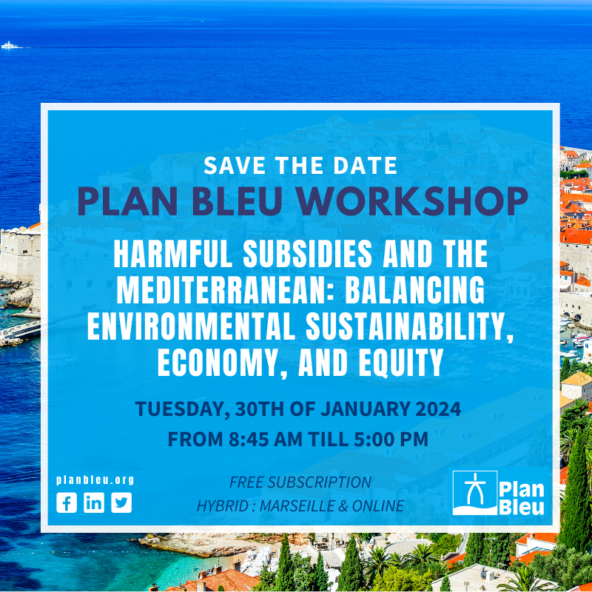
Fueling Algeria’s Future: Measuring the Footprint of Fossil Fuel Subsidies on The National Duality of “Water Stress-Energy” Consumption
Presented by: Dr Hadjer Boulila
a

Slide 2
Introduction
Algeria relies heavily reliance on fossil fuels,
The country's renewable energy capacity remains relatively low compared to its potential.
The high level of fuel subsidies and low energy efficiency in Algeria have been identified as key issues which stress the need for further research and policy action.
What is the impact of fossil fuel subsidies on the nexus water stress-energy consumption ?
a

Slide 3
What?
Why?
How ?
To fill a research gap
To Provide informed policy recommendations to level up the social welfare and to redirect public expenditures where it enhances sustainable transition
Employing (SVAR) model, to analyze government's fiscal policies, specifically fuel subsidies to uncover the nuanced connections among policy implications, water stress, and local energy usage.
Measure the footprint of fuel fossil subsidies on water stress and energy consumption
a

Slide 4
The content
Conceptualizing the interconnectedness between water-energy-fossil fuel
03
01
Results
02
methodology
04
Policy recommendations
a

Slide 5
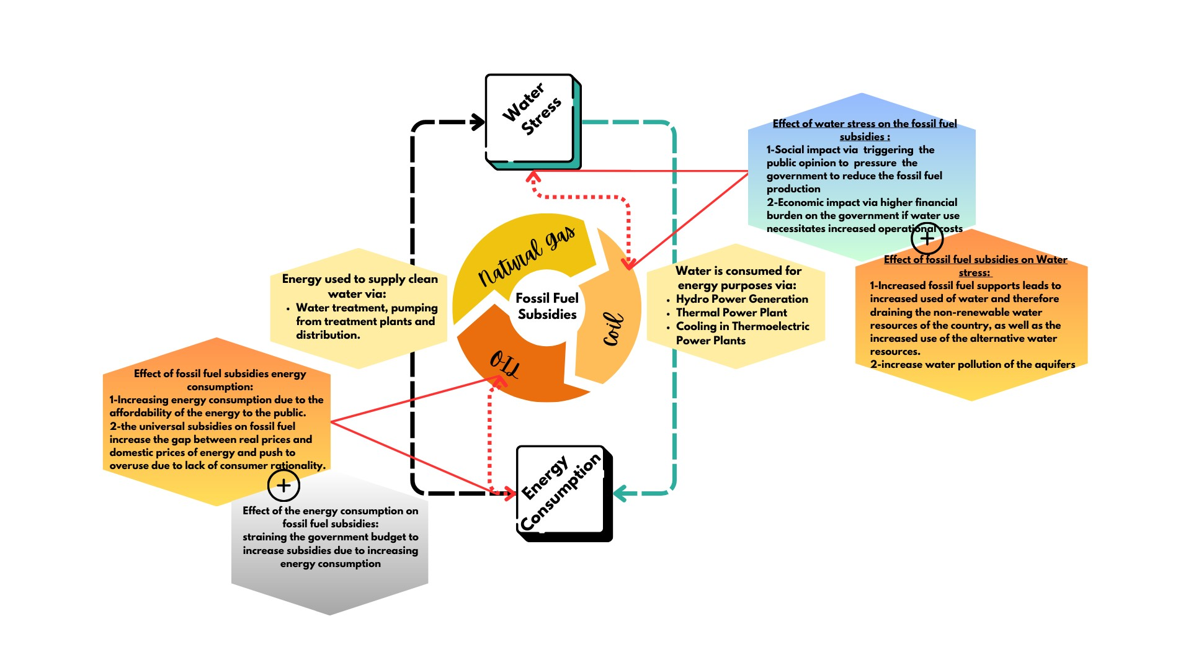
a

Slide 6
Methodology: structural Vectorauregressive model (SVAR)
FFS: fossil fuel subsidies
SVAR's ability to incorporate exogenous shocks makes it an ideal choice for assessing the impact of policy interventions specifically FFS as a fiscal policy tool on the interconnected domains of socio-economic (GDP, Inflation) and environmental factors.
WS: water stress
Variables
EC: energy consumption
GDP
Inflation
a

Slide 7
a

Slide 8
Null Hypothesis: | Obs | F-Statistic | Prob.
WS does not Granger Cause FFS | 47 | 0.76773 | 0.4705
FFS does not Granger Cause WS |  | 0.83781 | 0.0398
EC does not Granger Cause FFS | 47 | 3.09727 | 0.0156
FFS does not Granger Cause EC |  | 1.47686 | 0.0400
GDP does not Granger Cause FFS | 47 | 2.32198 | 0.1105
FFS does not Granger Cause GDP |  | 0.15385 | 0.8579
INFLATION does not Granger Cause FFS | 47 | 0.65827 | 0.5230
FFS does not Granger Cause INFLATION |  | 1.61265 | 0.2115
EC does not Granger Cause WS | 47 | 1.29616 | 0.2843
WS does not Granger Cause EC |  | 2.74682 | 0.0757
GDP does not Granger Cause WS | 47 | 1.08134 | 0.3484
WS does not Granger Cause GDP |  | 4.81242 | 0.0131
INFLATION does not Granger Cause WS | 47 | 2.31003 | 0.1117
WS does not Granger Cause INFLATION |  | 1.40134 | 0.2575
GDP does not Granger Cause EC | 47 | 4.58517 | 0.0158
EC does not Granger Cause GDP |  | 2.47810 | 0.0961
INFLATION does not Granger Cause EC | 47 | 0.32669 | 0.7231
EC does not Granger Cause INFLATION |  | 0.52483 | 0.5955
INFLATION does not Granger Cause GDP | 47 | 0.24437 | 0.7843
GDP does not Granger Cause INFLATION |  | 0.04893 | 0.9523
fossil fuel subsidies in Algeria have a significant impact on energy consumption and water stress rendering these subsidies harmful.
When the prices of fossil fuel including oil, coal, gas and electricity are lowered through subsidies, it encourages their overuse and inefficient consumption,
The energy sector is a significant consumer of fresh water, especially in the form of water-intensive cooling systems and hydropower.
The increased fossil fuel consumption, can rise greenhouse gas emissions that drive climate change which has a negative effect on water resources.
The extended effect of the support of fossil fuel prices affects the environmental well-being of the country

Slide 9
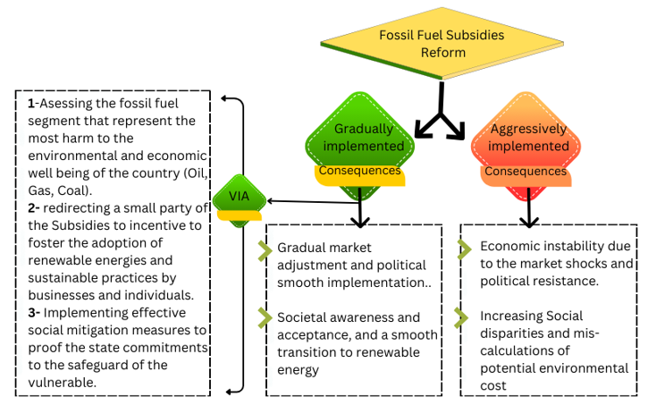
Policy recommendations
a

Slide 10
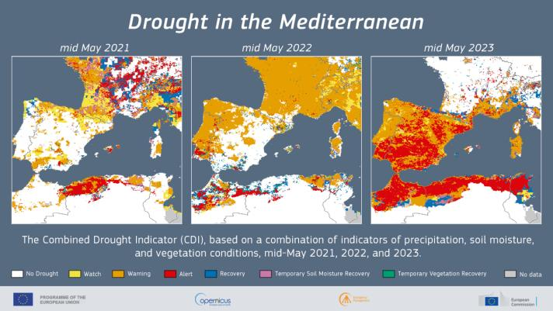
Policy recommendations for the region
Invest in the adoption of renewable energy sources to reduce dependence on fossil fuels.
Implement tax incentives for businesses in the energy sector that invest in and adopt water-efficient technologies.
Establishing a regional collaboration involving policymakers, researchers, and civil society organizations to unify management strategies and mitigate the harmful effect of FFS.
Promote environmental education programs to increase awareness about the importance of conservation and sustainable practices.

Slide 11
Thank you!
a

