Slide 1
Female labour inclusion and energy policies in the Mediterranean countries:
Evidence from a mixed methodology approach
Stella Tsani¹ Chrysoula Chitou² Karine Moukaddem³ Valentina Dedi⁴
¹ Department of Economics, National and Kapodistrian University of Athens
² Department of Economics, University of Ioannina
³ Aix-Marseille School of Economics, Aix-Marseille University
⁴ Greek Energy Forum
Regional workshop on “Environmentally Harmful Subsidies in the Mediterranean”
January 30th, 2024, Marseille, France

Slide 2
Female labour inclusion and energy policies in the Mediterranean countries: Evidence from a mixed methodology approach
Energy sector important in the production and employment landscape of the Mediterranean region
Policies, like subsidies and local employment support, have direct socio-economic implications that are important for a timely and just energy transition in the region
We investigate the links between energy policies and female employment in the Mediterranean region. Focus: subsidies and efforts to boost local employment
Empirical results confirm the negative links between hydrocarbon subsidies and female labor force participation
Need for balanced gender-focused policies
Interventions addressing information asymmetries and skills shortages

Slide 3
Methodology
Systematic Literature Review
Identify and assess existing knowledge on the links between energy subsidies and female employment in the Mediterranean
Empirical Assessment
Econometric analysis using latest datasets to examine the impact of subsidies on female employment
Survey Analysis in Greece
Exploring granular aspects of market dynamics and mechanisms driving gender equality

Slide 4
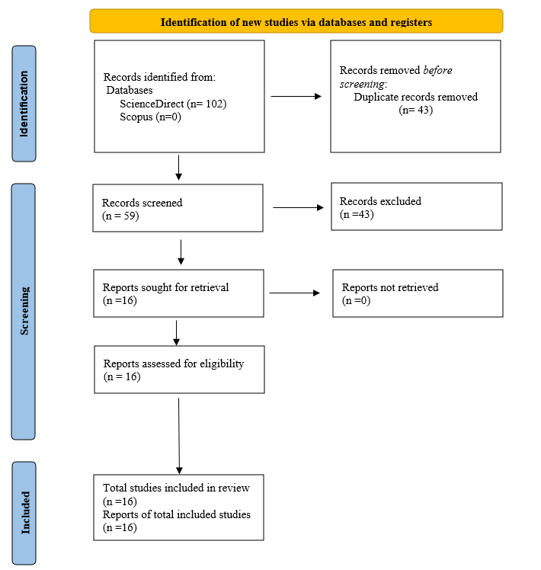
Systematic Literature Review
Notable gap on exploring the link between energy subsidies and female employment: No direct result found
Fossil fuel subsidies removal correlates with a drop in employment: No consensus on magnitude of adverse impact
For MENA region: employment drops in the short run, but increases in the long run, especially for the youth, by increasing allocative efficiency of production inputs
Some consensus on the need to mitigate the adverse effects by implementing a gradual reform and reinvesting the money saved into social welfare: when supporting policies are used, employment rises

Slide 5
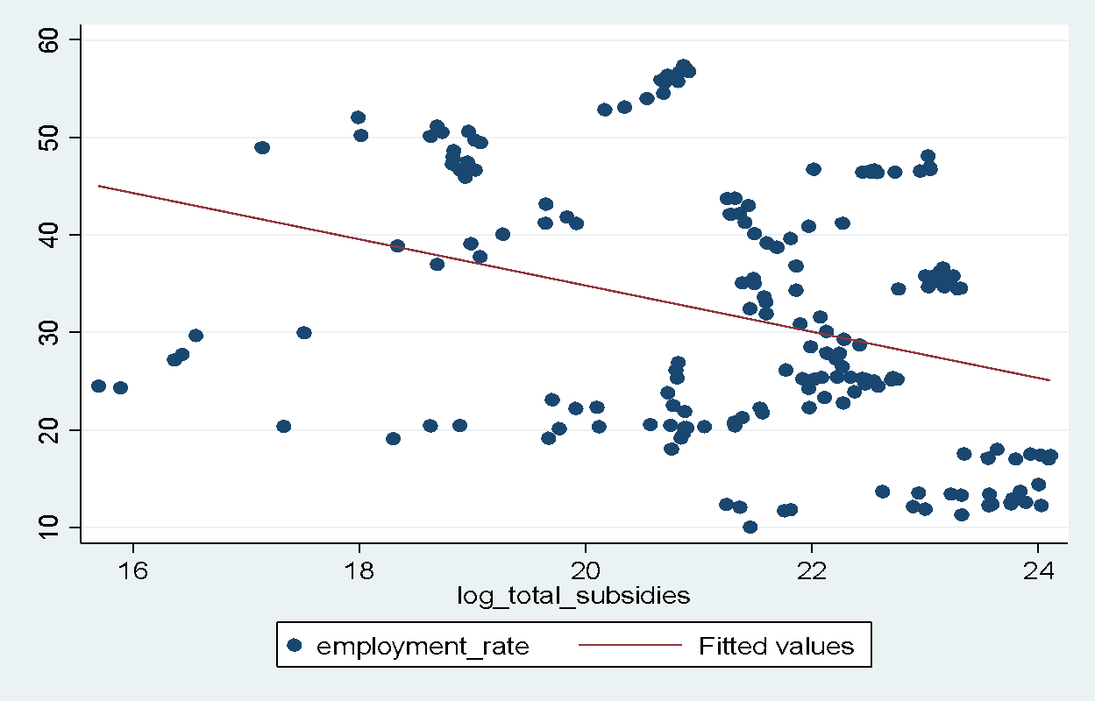
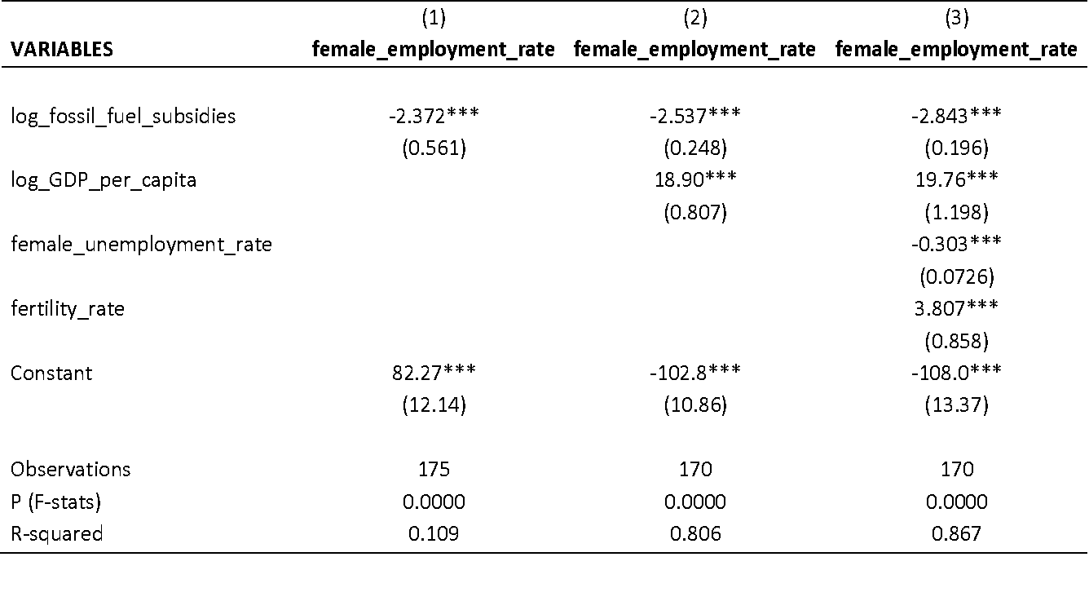
Empirical Assessment
Female employment rate and fossil fuel subsidies in the Mediterranean
Pooled OLS results
Period: 2010-2021
Data from 18 Mediterranean countries, including GDP per capita, female unemployment rate, fertility rates, and fossil fuel subsidies

Slide 6
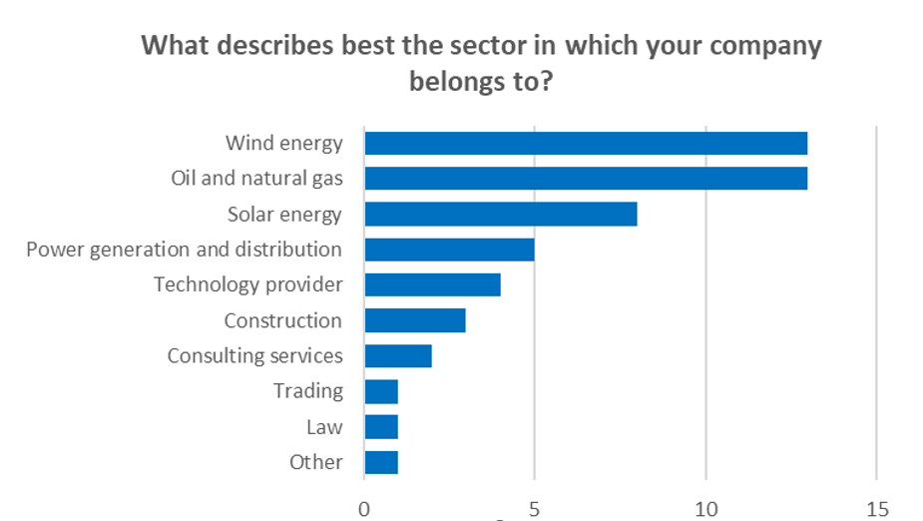
Survey Analysis in Greece
Online questionnaire developed to address issues related to talent pool availability and gender diversity.
139 energy companies in Greece reached out to respond.
Survey ran from November 21st, 2022, to February 22nd, 2023, allowing for comprehensive responses and industry representation.
51 responses collected, indicating a 36% response rate.

Slide 7
Women are well represented in the higher management ranks in my company
Not many women apply for employment in my company
Women account for less than half of the employees in my company
Tsani and Chitou acknowledge financial support from the EEA Grants 2014–2021, Bilateral Fund, under the project “Energy Governance for Sustainable Development”. The funding source has not been involved in the study design; in the collection, analysis and interpretation of data; in the writing of the article, and in the decision to submit the article for publication

Slide 8
Conclusions and Policy Recommendations
Policy Recommendations
Adopt Gender-Inclusive Policies:
Integrate gender-inclusive factors into energy policies.
Identify and eliminate barriers in regulations and policies hindering gender equality.
Promote equal opportunities in the energy sector and gender equality in leadership.
2. Promote Women-Friendly Energy Industry:
Include gender considerations in local employment policies.
Collaborate between governments, industry, and academia for an equitable energy sector.
Adopt gender-inclusive policies for recruitment, retention, and promotion.
3.Increase Data Gathering Initiatives:
Conduct data gathering initiatives to understand barriers to female economic inclusion.
Focus on the Mediterranean region and South Mediterranean countries.
Use local content to fight misinformation and biases about women in the energy sector.
4.Phasing Out Fossil Fuel Subsidies:
Gradually remove ineffective fossil fuel subsidies impacting female employment.
Reevaluate subsidies to ensure they do not hinder women's inclusion in the workforce.
5.Promote Gender-Focused Energy Transition:
Shift to cleaner and more sustainable energy sources.
Enhance women's inclusion in the labor market through renewable energy opportunities.

Slide 9
Stella Tsani
Thank you, comments welcomed
stsani@econ.uoa.gr

