Slide 1
ADDRESSING THE LINK BETWEEN FOSSIL FUEL SUBSIDIES AND CLIMATE CHANGE IN THE MEDITERRANEAN REGION Sevil Acar Bogazici University, Faculty of Managerial Sciences, Istanbul, Turkiye

Slide 2
Flow of the presentation
Motivation & background
Literature review
Analysis of OECD member states in the Mediterranean region
An in-depth focus on Turkiye’s FFS and its relationship with CO2 emissions
Conclusion and policy implications

Slide 3
Motivation & Background
Fossil fuels: the leading cause of increasing greenhouse gas (GHG) emissions
Governments have increasingly provided direct support for fossil fuels as well as tax incentives
Mediterranean countries are not well-known for their fossil fuel reserves; yet their governments subsidize the sector as well.

Slide 4
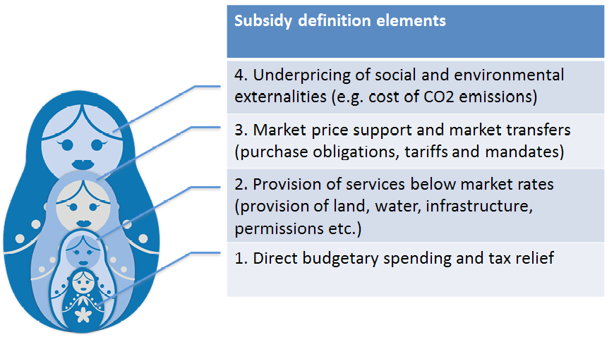
The Matryoshka Nesting Doll of Subsidy Definitions
Externalities are not technically subsidies but are a real cost to society
Our definition is based on the World Trade Organization’s Agreement on Subsidies and Countervailing Measures (ASCM), which is supported by 158 countries.
Source: The IISD Global Subsidies Initiative

Slide 5
Motivation & Background
The OECD Inventory of Support Measures for Fossil Fuels reports that direct transfers and tax expenditures associated with support measures for fossil fuels amounted to USD 427.9 billion in 2022.
IEA estimates that fossil fuels sold below market prices amounted to USD 1,126.6 billion in the same year.

Slide 6
Literature Review
There is a limited literature that assesses the socioeconomic and environmental impacts of FFS at national and global levels. For instance,
Kovacevic (2011): FFS have the potential to increase the cost of climate change mitigation by five times or 20-25% of a country’s GDP.
Solarin (2020): A 10% increase in FFS will increase the ecological footprint by between 0.3% and 1.5% in the selected 35 emerging and developing countries.
Arzaghi and Squalli (2023): High FFS are associated with greater emissions. High-subsidy countries emit about 11.4% more emissions than high-tax countries. They propose transitioning from a high-subsidy to a high-tax regime, which could reduce emissions by 1.28%.
There is a limited literature on FFS in Turkiye as well.
Acar et al. (2015) focuses on the incentives given to coal and renewable energy in Turkiye making an emphasis on the externalities from coal.
Acar and Yeldan (2016) that examines the macroeconomic and environmental effects of coal subsidies in Turkiye & finds that CO₂ emissions will decline significantly in both high- and low-income regions of Turkiye by 2030 if the production and investment subsidies provided to coal are removed. They find, a 5.4% emissions reduction compared to the base scenario at the country level.

Slide 7
Analysis of OECD member states in the Mediterranean region
OECD countries in the region are France, Greece, Israel, Italy, Portugal, Slovenia, Spain, and Turkiye (analysis for the period 2010-2021).
According to the OECD FFS Inventory, FFS are the sum of subsidies to:
End-use electricity + Natural gas + Petroleum + Coal
Alternatively, FFS are the sum of subsidies in the form of:
Producer Support Estimate + Consumer Support Estimate + General Services Support Estimate
Making use of this disaggregation, the following research questions are answered:
1. Which energy source do the incentives favor more in the region?
2. Is it the consumers, producers, or general services that acquire more FFS?
3. Does the total amount of FFS matter in determining the level of CO₂ emissions per capita in the region?
4. Does the type of energy source subsidized make a significant difference in CO₂ emissions per capita?
5. Does it make significant a difference in CO₂ emissions per capita whether FFS are provided to production, consumption, or general services?

Slide 8
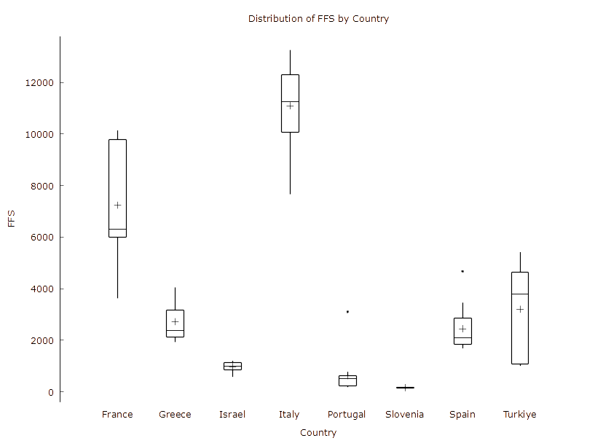
Figure 1. Distribution of FFS by country

Slide 9
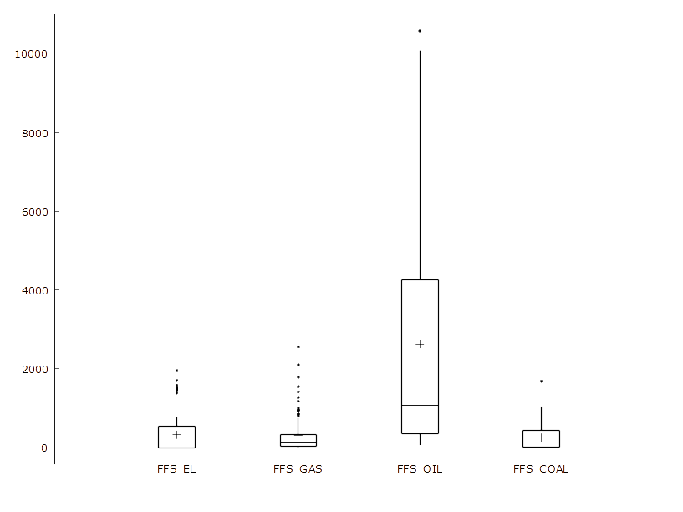
Figure 2. Distribution of FFS by fuel type in the region

Slide 10
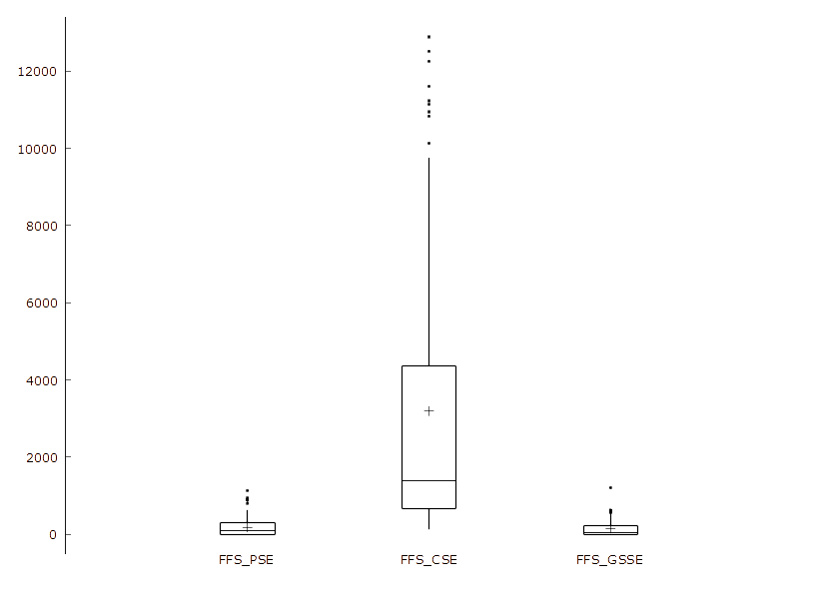
Figure 3. Distribution of FFS by beneficiary in the region

Slide 11
Table 1. Regression results for Mediterranean countries
 | Model 1 LN_CO2PC | Model 2 LN_CO2PC | Model 3 LN_CO2PC
Variable | Coefficient (Standard error) | Coefficient (Standard error) |  | Coefficient (Standard error)
LN_GDP | 0.502684 | 0.586926* |  | 0.571579***
 | (0.340252) | (0.351676) |  | (0.0995954)
LN_FFS | 0.0397057*
 | (0.0236488)
FFS_EL |  | −4.072e-05
 |  | (4.07573e-05)
FFS_GAS |  | 7.01580e-05***
 |  | (1.70562e-05)
FFS_OIL |  | 1.20466e-05
 |  | (1.31048e-05)
FFS_COAL |  | −7.930e-05
 |  | (7.42774e-05)
FFS_PSE |  |  |  | −2.556e-05
 |  |  |  | (6.32664e-05)
FFS_CSE |  |  |  | 1.331e-05*
 |  |  |  | (7.57352e-06)
FFS_GSSE |  |  |  | −8.901e-05
 |  |  |  | (8.46205e-05)
constant | −12.8386 | −14.8094 |  | −14.4036***
 | (9.08526) | (9.44593) |  | (2.66959)
time dummies | yes | yes |  | yes
Observations | 96 | 96 |  | 96
Number of id | 8 | 8 |  | 8
LSDV R-squared | 0.999443 | 0.999477 |  | 0.999452
Robust standard errors in parentheses *** p<0.01, ** p<0.05, * p<0.1

Slide 12
An in-depth focus on Turkiye’s FFS and CO₂ emissions
The following incentive mechanisms in TR are elaborated:
Aid to hard coal in the form of direct transfers from the Treasury
Coal aid to poor families
R&D expenditures
Exploration subsidies
Investment incentive schemes (e.g. Region V incentives for coal investments)
Tax expenditures
Price guarantee
Capacity mechanism
Payments to vulnerable households for covering their electricity consumption
Cash transfer program for vulnerable households to match their heating bills

Slide 13
Table 2. Fossil Fuel Support in Turkiye (Total support in million USD) Source: OECD FFS Inventory
Country |  |  |  | TUR: Türkiye
Support Mechanism |  |  |  | Total
Unit |  |  |  | US Dollars (nominal) [in millions]
Year |  |  |  | 2010 | 2011 | 2012 | 2013 | 2014 | 2015 | 2016 | 2017 | 2018 | 2019 | 2020 | 2021 | 2022
Beneficiary or Sector |  | Fuel Type
Total |  | End-use electricity |  | 0 | 0 | 0 | 0 | 0 | 0 | 0 | 0 | 0 | 52.659 | 74.927 | 62.829 | 244.772
 |  | Natural gas |  | 1.304 | 1.448 | 1.317 | 1.304 | 26.283 | 63.652 | 46.244 | 90.804 | 204.033 | 169.169 | 156.86 | 160.585 | 168.273
 |  | Petroleum |  | 344.176 | 352.372 | 344.991 | 347.354 | 4043.57 | 3698.937 | 3635.145 | 4364.686 | 4180.819 | 2999.015 | 2290.606 | 1779.383 | 1645.622
 |  | Coal |  | 652.632 | 728.137 | 725.709 | 744.321 | 600.66 | 645.822 | 868.35 | 967.496 | 627.316 | 675.667 | 665.134 | 604.238 | 268.3
 |  | Total |  | 998.113 | 1081.957 | 1072.016 | 1092.978 | 4670.512 | 4408.41 | 4549.739 | 5422.986 | 5012.168 | 3896.51 | 3187.527 | 2607.035 | 2326.967
Beneficiary | Producer Support Estimate | End-use electricity |  | 0 | 0 | 0 | 0 | 0 | 0 | 0 | 0 | 0 | 0 | 0 | 0 | 0
 |  | Natural gas |  | 0 | 0 | 0 | 0 | 25.19 | 63.207 | 45.909 | 90.53 | 64.858 | 62.66 | 50.609 | 47.856 | 30.453
 |  | Petroleum |  | 0 | 0 | 0 | 0 | 166.593 | 134.504 | 171.409 | 217.762 | 196.701 | 163.718 | 97.955 | 138.266 | 136.862
 |  | Coal |  | 303.623 | 286.217 | 258.553 | 298.055 | 287.863 | 347.484 | 416.005 | 590.882 | 235.533 | 256.345 | 263.881 | 213.676 | 114.182
 |  | Total |  | 303.623 | 286.217 | 258.553 | 298.055 | 479.647 | 545.196 | 633.323 | 899.174 | 497.093 | 482.724 | 412.444 | 399.798 | 281.497
 | Consumer Support Estimate | End-use electricity |  | 0 | 0 | 0 | 0 | 0 | 0 | 0 | 0 | 0 | 52.659 | 74.927 | 62.829 | 244.772
 |  | Natural gas |  | 0 | 0 | 0 | 0 | 0 | 0 | 0 | 0 | 139.121 | 106.454 | 106.2 | 112.696 | 137.802
 |  | Petroleum |  | 338.025 | 346.577 | 338.743 | 339.876 | 3869.751 | 3560.804 | 3460.866 | 4144.594 | 3983.857 | 2835.057 | 2192.423 | 1640.944 | 1508.66
 |  | Coal |  | 296.259 | 389.742 | 413.761 | 391.789 | 260.584 | 268.97 | 425.08 | 353.606 | 389.344 | 416.901 | 349.239 | 349.261 | 132.034
 |  | Total |  | 634.284 | 736.319 | 752.505 | 731.665 | 4130.336 | 3829.774 | 3885.947 | 4498.199 | 4512.322 | 3411.07 | 2722.79 | 2165.731 | 2023.268
 | General Services Support Estimate | End-use electricity |  | 0 | 0 | 0 | 0 | 0 | 0 | 0 | 0 | 0 | 0 | 0 | 0 | 0
 |  | Natural gas |  | 1.304 | 1.448 | 1.317 | 1.304 | 1.092 | 0.444 | 0.336 | 0.274 | 0.053 | 0.055 | 0.051 | 0.033 | 0.018
 |  | Petroleum |  | 6.151 | 5.795 | 6.247 | 7.477 | 7.225 | 3.628 | 2.869 | 2.33 | 0.261 | 0.24 | 0.228 | 0.173 | 0.1
 |  | Coal |  | 52.75 | 52.178 | 53.394 | 54.478 | 52.212 | 29.368 | 27.265 | 23.009 | 2.439 | 2.421 | 52.014 | 41.3 | 22.084
 |  | Total |  | 60.206 | 59.421 | 60.958 | 63.258 | 60.53 | 33.44 | 30.47 | 25.613 | 2.753 | 2.715 | 52.293 | 41.507 | 22.202
Sector | Fossil-fuel Production | End-use electricity |  | 0 | 0 | 0 | 0 | 0 | 0 | 0 | 0 | 0 | 0 | 0 | 0 | 0
 |  | Natural gas |  | 1.304 | 1.448 | 1.317 | 1.304 | 26.283 | 63.652 | 46.244 | 90.804 | 204.033 | 169.169 | 156.86 | 160.585 | 143.946
 |  | Petroleum |  | 6.151 | 5.795 | 6.247 | 7.477 | 173.818 | 138.132 | 174.279 | 220.092 | 196.962 | 163.958 | 98.183 | 138.439 | 136.868
 |  | Coal |  | 356.374 | 338.395 | 311.947 | 352.532 | 340.075 | 376.852 | 443.27 | 613.891 | 377.439 | 471.202 | 491.776 | 438.324 | 179.662
 |  | Total |  | 363.829 | 345.638 | 319.511 | 361.313 | 540.177 | 578.636 | 663.793 | 924.787 | 778.433 | 804.329 | 746.819 | 737.348 | 460.476
 | Residential | End-use electricity |  | 0 | 0 | 0 | 0 | 0 | 0 | 0 | 0 | 0 | 52.659 | 74.927 | 62.829 | 244.772
 |  | Natural gas |  | 0 | 0 | 0 | 0 | 0 | 0 | 0 | 0 | 0 | 0 | 0 | 0 | 24.328
 |  | Petroleum |  | 0 | 0 | 0 | 0 | 0 | 0 | 0 | 0 | 0 | 0 | 0 | 0 | 0
 |  | Coal |  | 296.259 | 389.742 | 413.761 | 391.789 | 260.584 | 268.97 | 425.08 | 353.606 | 249.877 | 204.465 | 173.358 | 165.913 | 88.731
 |  | Total |  | 296.259 | 389.742 | 413.761 | 391.789 | 260.584 | 268.97 | 425.08 | 353.606 | 249.877 | 257.124 | 248.285 | 228.742 | 357.832
 | Electricity Generation | End-use electricity |  | 0 | 0 | 0 | 0 | 0 | 0 | 0 | 0 | 0 | 0 | 0 | 0 | 0
 |  | Natural gas |  | 0 | 0 | 0 | 0 | 0 | 0 | 0 | 0 | 0 | 0 | 0 | 0 | 0
 |  | Petroleum |  | 0 | 0 | 0 | 0 | 79.945 | 74.596 | 75.838 | 75.365 | 68.564 | 4.993 | 0 | 0 | 0
 |  | Coal |  | 0 | 0 | 0 | 0 | 0 | 0 | 0 | 0 | 0 | 0 | 0 | 0 | 0
 |  | Total |  | 0 | 0 | 0 | 0 | 79.945 | 74.596 | 75.838 | 75.365 | 68.564 | 4.993 | 0 | 0 | 0
 | Transportation | End-use electricity |  | 0 | 0 | 0 | 0 | 0 | 0 | 0 | 0 | 0 | 0 | 0 | 0 | 0
 |  | Natural gas |  | 0 | 0 | 0 | 0 | 0 | 0 | 0 | 0 | 0 | 0 | 0 | 0 | 0
 |  | Petroleum |  | 0 | 0 | 0 | 0 | 1785.95 | 1613.042 | 1567.764 | 1374.249 | 1250.673 | 971.761 | 534.006 | 491.793 | 487.272
 |  | Coal |  | 0 | 0 | 0 | 0 | 0 | 0 | 0 | 0 | 0 | 0 | 0 | 0 | 0
 |  | Total |  | 0 | 0 | 0 | 0 | 1785.95 | 1613.042 | 1567.764 | 1374.249 | 1250.673 | 971.761 | 534.006 | 491.793 | 487.272
 | Other | End-use electricity |  | 0 | 0 | 0 | 0 | 0 | 0 | 0 | 0 | 0 | 0 | 0 | 0 | 0
 |  | Natural gas |  | 0 | 0 | 0 | 0 | 0 | 0 | 0 | 0 | 0 | 0 | 0 | 0 | 0
 |  | Petroleum |  | 338.025 | 346.577 | 338.743 | 339.876 | 2003.857 | 1873.166 | 1817.263 | 2694.979 | 2664.62 | 1858.302 | 1658.417 | 1149.152 | 1021.388
 |  | Coal |  | 0 | 0 | 0 | 0 | 0 | 0 | 0 | 0 | 0 | 0 | 0 | 0 | 0
 |  | Total |  | 338.025 | 346.577 | 338.743 | 339.876 | 2003.857 | 1873.166 | 1817.263 | 2694.979 | 2664.62 | 1858.302 | 1658.417 | 1149.152 | 1021.388

Slide 14
Fossil Fuel Support by beneficiary (million USD) Source: OECD FFS Inventory

Slide 15
Fossil Fuel Support by fuel type (million USD) Source: OECD FFS Inventory

Slide 16
Table 3. Costs of electricity production from coal, 2018 (USD/kWh)
 | Costs of coal
LCOE* | 0,055
Subsidies including lignite exploration incentives, direct Treasury transfers, rehabilitation aid to power plants in the privatization process, budget expenditures for new coal power plants, support within the framework of the regional investment incentive system, profits transferred to coal enterprises through coal aid to the poor** | 0,007
Capacity mechanism remuneration*** | 0,003
Purchase guarantee for domestic coal at a price above the market price**** | 0,004
Total | 0,070
Source: Author’s calculations from the following sources: * SHURA (2020) Optimum Capacity Mix Report, ** Acar et al. (2015), *** TEİAŞ, **** Aytaç (2020) and SHURA (2019).

Slide 17
GHG emissions versus FFS types with respect to fuel type

Slide 18
GHG emissions from energy versus FFS types with respect to fuel type

Slide 19
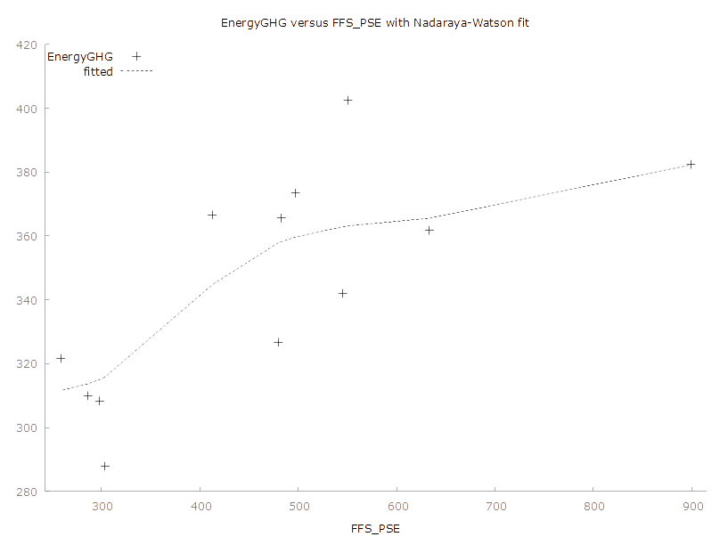
GHG emissions from energy versus FFS_PSE

Slide 20
Conclusion and Policy Implications
FFS have the potential to increase CO₂ emissions both in the region and in Turkiye thereby bearing a cost on the attempts to mitigate climate change.
Eliminating FFS (especially those provided to natural gas as well as to consumers) in the region and specifically in Turkiye (especially those provided to coal and natural gas as well as to producers) will facilitate improvements in energy efficiency and the deployment of renewable energy sources, thereby contributing to the efforts to mitigate GHG emissions in the region and combat climate change.
The findings can guide policy-makers in the region reshaping the policy tools that are intended to contribute to climate change mitigation and a transition to renewable energy.

