Slide 1
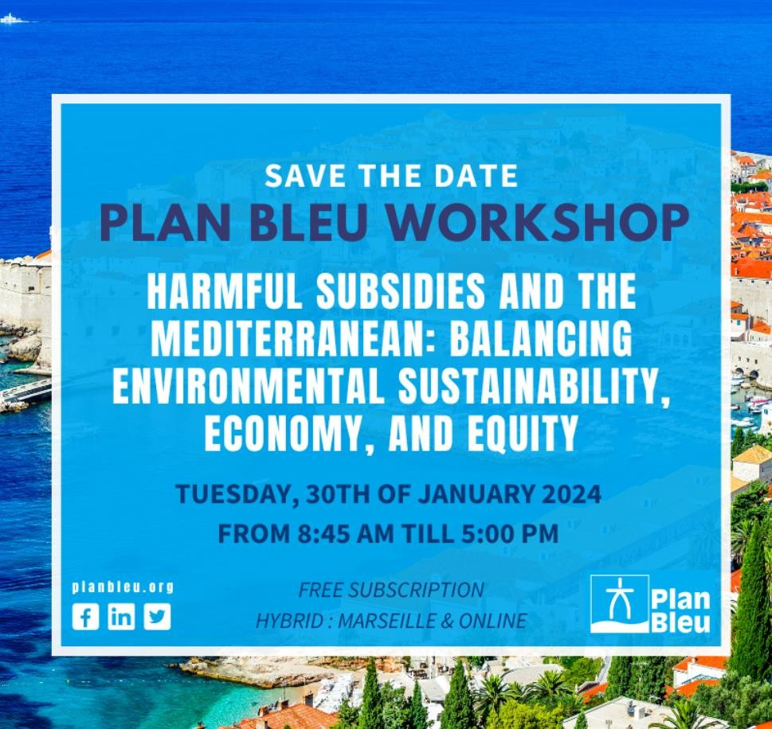
The antagonistic effects of tourism industry strategies on land use management:
A comparative analysis of Toulon (France) and Kusadasi (Turkey)
Vincent Monier
(ESPI Group)
& Myriam Ben Saad
(Kedge Business School)

Slide 2
Summary
Objective
Approach: Comparative and
prospective spatial
analysis
Model: Transition Matrix
Results
Policy recommandations
2

Slide 3
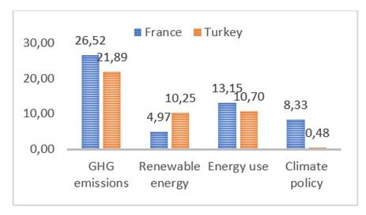
Objectives
Tourism is recognised as a sector that is highly sensitive to the impact of climate change (Dogru et al., 2019; Scott et al., 2012, Scott et al., 2016).
Tourism is developing by itself and doesn’t need any subside.
The few subsidies granted to this activity are positive to the environment.
Analyze consequences of tourism policies on the Mediterranean coast
Examine the evolution of land use in the Mediterranean basin using the diachronic method
Visualise the effects of tourism development in Toulon (France) and Kusadaci (Turkey)
Draw up a prospective study of foreseeable changes in land cover thanks to a transition matrices for each territory and type of land use identified.
Graph 1: Climate Change Performance Index, 2024
Source: CCPI.org, 2024
cover t
type of
3

Slide 4
General data about Tourism sector in Kusadasi
Tourism in Turkey generated $19.5 billion for the country in 2010 and helped reduce the trade deficit by 36.52%.
entries by sea in Kusadasi = 529,722 passengers 517 ships in 2010 (ahead of Istanbul)
Direct investment by the Treasury Sub-Secretariat in the province of Aydin:
Year | LT subsidy | Grant in euros | Jobs created
2007 | 70,007,115 | 37,840,000 | 870
2008 | 59,858,316 | 28,133,408 | 555
2009 | 49,712,567 | 22,909,017 | 514
2010 | Unknown | Unknown | unknown
By 2022: 3.2 million tourists to the Aydin district, including over 2 million to Kusadasi
Estimated economic value: $2.5 billion

Slide 5
General data about Tourism sector in Toulon area
TPM welcomed more than 3.5 million tourists in 2016, making it the leading tourist destination in the Var in 2016, with 24% of overnight stays in the department.
Tourism accounts for almost €900,000 million in spending and 6,400 direct jobs in the region.
In 2016: 312,946 cruise passengers
50% of visitors in summer, 92% French, 8% foreign, of which 60% in self-catering accommodation
 | Visitor numbers tourist | Number of overnight stays | Estimated expenditure in euros | Number of cruise passengers
Kusadasi | Over 2 million by 2022 |  | 2.3 billion by 2022 | 567,290 in 2015
TPM | 4 million in 2010 | 29.2 million | 1.5 billion in 2010 | 472,252 in 2017

Slide 6
Regional Grant available for tourism development in TPM Area(1)
Subsidy | Target audience | Maximum funding (€) and funding method
Limiting the impact of moorings and guaranteeing the sustainable development of nautical activities and tourism | Public organisations | 80% max for the study part of the total cost Capital expenditure: up to 40% (max €200K)
Strengthen the resilience of the region and its ecological functions, by ensuring their restoration while reducing sources of pressure. | Public organisations and associations | The grant awarded may not exceed a maximum of 80% of the eligible amount.
Reveal biodiversity as a source and driver of sustainable, innovative economic development to inject dynamism into all the region's regions. | Companies, local authorities and/or associations | Max 80% of the eligible amount is subject to EU funding rules, in particular the de minimis regulation no. 1407/2013 of 18 December 2013.
Adoption by the region of the "Trait de Côtes" scheme, which will also make it possible to rethink the level of service and quality of the seaside tourism offering. | EPIC (community of municipalities, agglomerations, metropolises) | Part 1: 50% of the total cost of the project, up to a maximum of €200,000. Part 2: - 30% of the total value of the project, up to a maximum of €3 million for the works -50% of the total cost of the project, up to a maximum of €200,000 for engineering. Part 3: 50% of the total cost of the project, up to a maximum of €200,000 for both works and engineering.
Most of them look like t
o benefit to the environ
ment

Slide 7
Regional Grant available for tourism development in TPM Area(2)
Subsidy | Target audience | Maximum funding (€) and funding method
Enhancing natural sites. | Managers of major tourist sites and "alternative" sites Department, EPCI, association, company, nature park, local authority, tourist office... | Strands 1 and 2: -40% maximum of eligible capital expenditure, up to a maximum of €200,000 Strand 3: maximum 60% of eligible capital expenditure. Maximum €80,000 per project
Helping to develop out-of-season business tourism. | The organisers of the event | Provisional figures for overnight stays and net exhibition area, declared by the promoter (after verification by CR). Overnight stays counted = overnight stays by participants (not exhibitors) exclusively between the 1st day and the last day of the event.
Support for tourist accommodation | All VSEs and SMEs, SCIs or property companies, traditional independent hotels, open-air hotels, holiday villages and centres and youth hostels, | Investment of up to €100,000 at a rate of 60%, supplemented by a Sustainable Development bonus (between €5,000 and €10,000) awarded on presentation of proof of obtaining or renewing an environmental label.
Investour, to grow and consolidate your equity capital | VSEs hiring seasonal workers. SMEs in the tourism sector. | equity loans, between €50,000 and a maximum of €350,000, subject to the de minimis rule

Slide 8
Direct tourism subsidies in Kusadasi disctrict (1)
Subsidy | Target audience | Funding planned over 5 years (2020- 2024)
Promoting tourism in Kusadasi | General public | 11 603 825 TL 353,394 €
Increasing Kusadasi's share of Turkish tourism | Tourists | 14 642 923 TL 445,950 €
Ensuring the development of alternative tourism such as spa tourism | Tourists | 42,986,980 TL 1,309,168 €
Encouraging the development of organic farming | Turkish farmers + Tourists | 22,544,608 TL 686,596 €
Strengthening the twinning with the town of Sinaia (Romania) through sustainable tourism | Municipality of Kusadasi | 125,447 (ERDF over 11 months)

Slide 9
Specific (i.e local) grant helping (un)directly tourism development in TPM area (1)
Objective | Number of projects/actions | Amount (€)
Reduce bacteriological, chemical, nitrate and pesticide pollution and waste in natural environments | 100 projects, 27 project owners | 67,300,000
Ensuring sustainable and balanced management of water resources, to better adapt to the effects of climate change | 31 projects, 14 project owners | 11,400,000
Sustainable management of watercourses and wetlands, in conjunction with risk prevention | 52 projects, 8 project owners | 5,400,000
Sustainable management of the land-sea interface and the marine environment | 37 projects, 14 project owners | 4,400,000
Reinforce the integration of "WATER" issues in urban planning documents | 4 projects, 4 owners | 20,000
TOTAL | 224 projects, 67 project owners | 88,520,000
Key figures for the “Contrat
de Baie” :
Surface of the marine area: 500 km².
3 islands, two of which are in the heart of one National Park (One of the two Marine and terrestrial national park in France) .
Coastline: 270 km.
28 municipalities, including 10 coastal municipalities and 6 intercommunal bodies.
27 ports.

Slide 10
Specific (i.e local) grant helping (un)directly tourism development in TPM area (1)
Examples of actions undertaken as part of the Opération Grand Site-Giens structuring project (2019-2029)
Actions |  |  |  | Amounts (total of actions carried out or planned) € (in euros)
1-Creating a sustainable mobility plan in line with the metropolitan Urban development plan |  |  |  | 6,524,547
2 - Creating gateways to Tombolos and Ayguade-Salins |  |  |  | 885,000
3 - Define a landscape policy to upgrade the Grand Site's entrances and roads |  |  |  | 65,000
4 - Design and implement an overall information master plan for the Grand Site |  |  |  | Unknown
Enhancing the Hyères salt marsh sites |  |  |  | 10,722,000
6 - Define the principles of access, development and management of the Grand Site's beaches |  |  |  | 7,800,000 (€780k/y)
7 - Promoting and upgrading the Grand Site's tourism offering |  |  |  | Unknown
8 - Implement a plan to promote the Grand Site's points of interest |  |  |  | 25,000
9 - Restoring the public continuity of major walking routes: Coastal footpath. |  |  |  | 1,390,836
25- Implement an ecological continuity management plan |  |  |  | 1,328,000
11 - Upgrading heritage public spaces in the village of Giens |  |  |  | 1,290,812
12 - Upgrading the heritage public spaces of La Tour Fondue |  |  |  | 5,269,396
35 projects TOTAL | Completed or committed | Short term | Medium-term
 | 8,464,572 | 15,299,000 | 21,212,000

Slide 11
Policy of land management of sensitive natural areas in TPM
Acquisition by the” Conservatoire du Littoral” in the TPM coastal zone studied (1976 - 2023, Purchase, transfer or dation)
Location | Surface area (Ha)
Hyères-les-Palmiers | 80
Carqueiranne | 167
Six-Fours-les-Plages | 15,5
Giens peninsula | 126
Toulon | 2
Le Pradet | 205
The Hyères salt marshes | 957
La Seyne-sur-Mer | 50
Port-Cros Island | 285
Porquerolles Island | 237,4
Saint-Mandrier-sur-Mer | 109
TOTAL | 2227

Slide 12
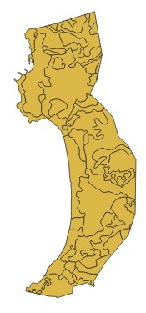
Studied areas : A 5 Km strip coastline
Scale: 1/200 000
Source: CLC, 2018, extraction by the authors, 2023
Scale 1/200 000
Source: CLC, 2018, extraction b the authors, 2023

Slide 13
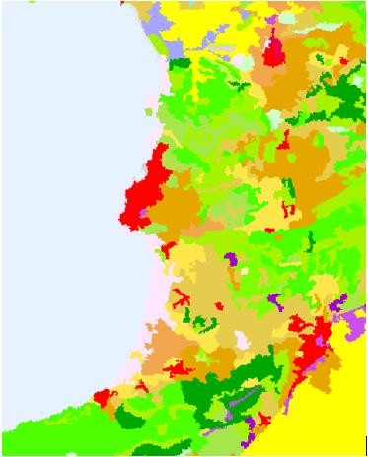
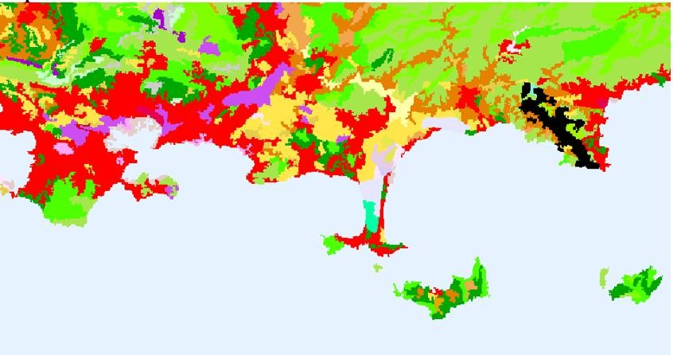
Comparative and prospective spatial analysis methods: TPM vs Kusadaci
Map 02: Land use of Kusadasi, 2018
Map 01. Land use of Toulon in 2018.
Source: Corine Land Cover, 2018, extraction by the authors, 2023
11

Slide 14
Transition Matrix : Application of the Markov chain to changes in land use in Toulon and Kusadasi.
Category | Symbol | CLC
Urban Area | UA | 111 + 112 + 113
Recreational area | RA | 114
Cultivated land | CL | 221 +222
Meadows | M | 223
Heterogeneous agricultural areas | HAA | 224
Forests | F | 331
herbaceous vegetation associations | HVA | 332
Open spaces with little or no vegetation | SNV | 333
wetlands | WL | 441 + 442
Coastal lagoons | COL | 521
UA RA CL M HAA F HVA
1616 2206 3280 0 5880 8352 3904
SNV WL COL
0 0 0 for Kusadasi
38664 946 2156 1484 772 6767 1616 414 873 160 for TPM
^{V}2018 ^{= U}2019 ⁼
Table 1 : Transition matrix K_{4°C}
 |  | K >4°C
 |  | UA |  | RA | CL | M | HAA | F | HVA | SNV | WL | COL
 | UA | 0,980 |  | 0,020 | 0 | 0 | 0 | 0 | 0 | 0 | 0 | 0
 | RA | 0 |  | 1 | 0 | 0 | 0 | 0 | 0 | 0 | 0 | 0
 | CL | 0,045 |  | 0,007 | 0,918 | 0 | 0 | 0 | 0,01 | 0,02 | 0 | 0
 | M | 0 |  | 0 | 0 | 1 | 0 | 0 | 0 | 0 | 0 | 0
 | HAA | 0,013 |  | 0,009 | 0 | 0 | 0,958 | 0 | 0 | 0,02 | 0 | 0
 | F | 0,001 |  | 0 | 0 | 0 | 0 | 0,959 | 0,015 | 0,025 | 0 | 0
 | HVA | 0,002 |  | 0 | 0 | 0 | 0 | 0 | 0,973 | 0,025 | 0 | 0
 |  |  |  | 0 | 0 | 0 | 0 | 0 | 0 | 1 | 0 | 0
 | SNV |  | 0
 | WL |  | 0 | 0 | 0 | 0 | 0 | 0 | 0 | 0 | 1 | 0
 | COL |  | 0 | 0 | 0 | 0 | 0 | 0 | 0 | 0 | 0 | 0
Source: Author’s calculation, 2023
12

Slide 15
Simulation of UN SSP to TPM & Kusadasi
 | Types |  | Adaptation challenge/Mitigation | Scenario | Simulated scenario for TPM and Kusadasi |  | Temperature rise match up
 |  |  | challenge |  | Yes | NO
 | SSP1 |  | Low/Low | Very ambitious scenario to meet the 1.5°C target of the Paris Agreement | X |  | <1,5°c
 | SSP2 |  | Medium/Medium | Sustainable development scenario | X |  | 1,5°C to 2,5°c
 | SSP3 |  | High/High | Intermediate scenario | X |  | 2,5°C to 3°C
 | SSP4 |  | High/Low | Scenario of regional rivalries |  | X
 | SSP5 |  | Low/High | Development based on fossil fuels | X |  | >4°C
13

Slide 16
Results : Effects of Toulon’s tourism development and climate change impacts on land use.
Land use in TPM in 2034 (in ha)
Land use in TPM in 2074 (in Ha)
Land use in Toulon in 2104 (in ha)
100000
100000
100000
10000
1000
10000
10000
1000
1000
100
100
100
10
10
10
1
1
1
UA RA 2074 < 1,5°C
CL M HAA F HVA SNV
1,5°C > 2074 <2,5 °C
UA RA CL M
2039 < 1,5°C
2034 < 2,5°C
HAA F HVA SNV WL COL
1,5°C > 2039 <2,5 °C
2039 = 4°C
WL COL
UA RA CL
2104 < 1,5°C
2104< 2,5°C
M HAA F HVA SNV WL COL
1,5°C > 2104 <2,5 °C
2104 = 4°C
2074 < 2,5°C
2074 = 4°C
14

Slide 17
Results : Effects of Kusadasi tourism development and climate change impacts on land use occupation
Land use in Kusadasi in 2036 (in ha)
Land Use in Kusadasi in 2072(in ha)
Land Use in Kusadasi 2102 (in ha)
10000
10000
8000
6000
4000
2000
0
10000
8000
6000
4000
2000
0
8000
6000
4000
2000
0
UA
RA CL
Kusadasi w/o CC
HAA
F
HVA
SNV
UA
RA CL
Kusadasi w/o CC
HAA F HVA SNV
1,5>Kusadasi<2,5°C
UA
RA CL
Kusadasi w/o CC
HAA F HVA SNV
1,5>Kusadasi<2,5°C
1,5>Kusadasi<2,5°C
Kusadasi < 2,5 °C
Kusadasi 4°C
Kusadasi < 2,5 °C
Kusadasi 4°C
Kusadasi < 2,5 °C
Kusadasi 4°C
15

Slide 18
Policies recommendations
Mitigating climate change may require a combination of different actions. This could include market-based economic incentives, such as taxes, liability payments, emission rights, subsidies from a green fund, as well as tourism reforms and socio-cultural transformations, particularly at the local level.
Draw up integrated local climate plans, along the lines of the "Future lies in Tourism" program, which aims to strengthen the capacity of local tourism actors and NGOs to contribute to sustainable tourism development through partnerships with public and private institutions (UNDP, 2022).
From the point of view of both research and policy recommendations, it seems imperative to use a local scale :
a better understanding of past and future land use management would enable strong measures to preserve the environmental capital that is essential to maintaining/developing the tourism sector.
Respecting or tightening Urban Planning Acts (like “ZAN” in France) would help regulate new construction.
Finally, to help decision-makers, we propose the development of a mapping tool to measure the short-, medium- and long-term impact of tourism developments (whatever the size or type of infrastructures) on the environment.
But it is just as essential to maintain a coherent regional strategy for preserving the land-sea interface in the Mediterranean area through the production a coalition of interest for all the stakeholders

