Slide 1
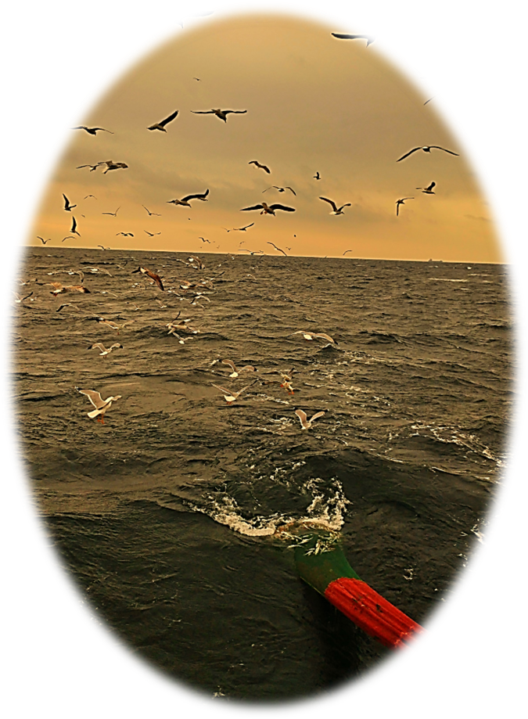

Fishing Subsidies and Their Impacts on Marine Ecosystem Health:
The case of Türkiye
Nazli Demirel - Pinar Ertor-Akyazi - Taner Yildiz
ndemirel@istanbul.edu.tr

Slide 2
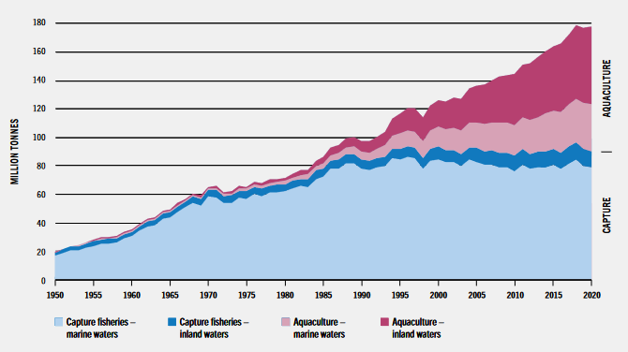
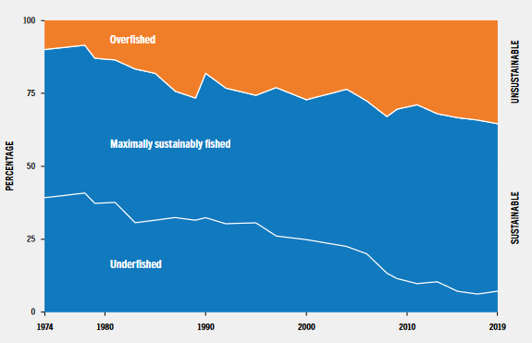
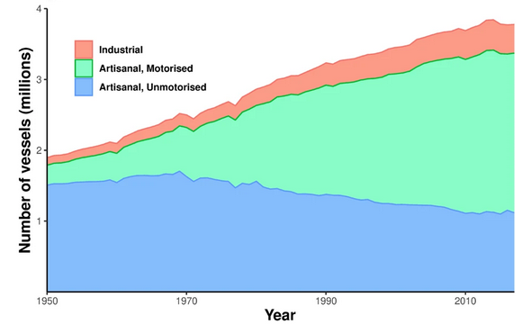
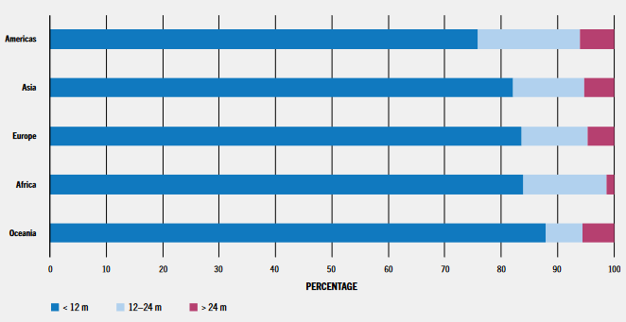
Global Fisheries
Marine capture fisheries have plateaued since 1995
Fishing vessels has escalated dramatically
Majority of fisheries small scale (<12 m length)
Increasing overfished stocks to its double
(FAO, 2022)
(Nature, 2024)

Slide 3
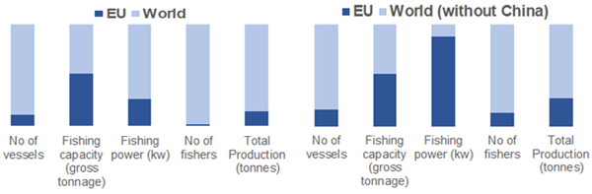
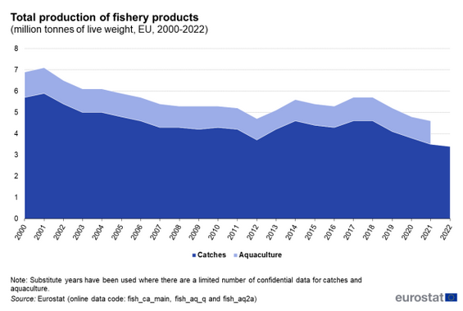
EU Fisheries
Marine capture fisheries slightly decreasing
Fishing power is very high, number of vessel is low
Majority of stocks are unsustainable
Increasing overfished stocks to its double
(Arthur et al. 2019, IIED)
(Froese et al. 2018, Marine Policy)

Slide 4
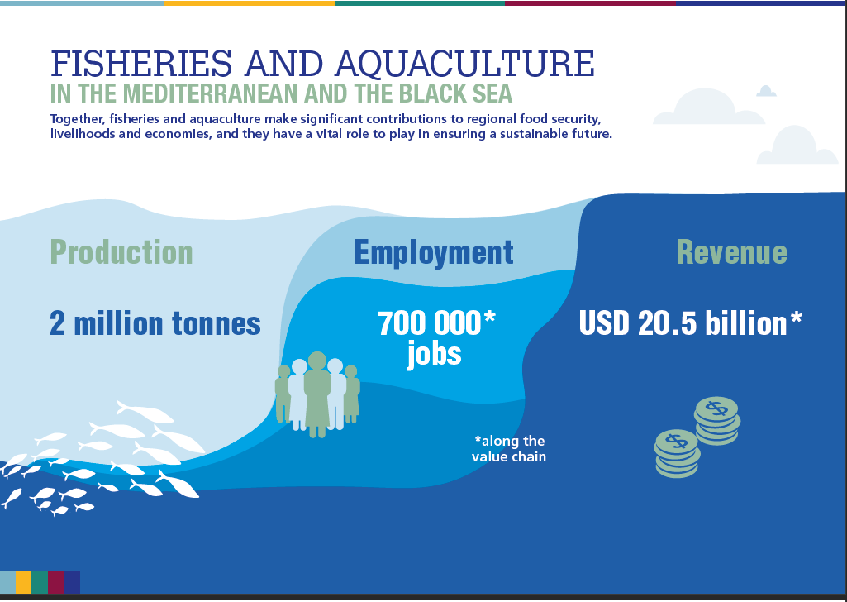
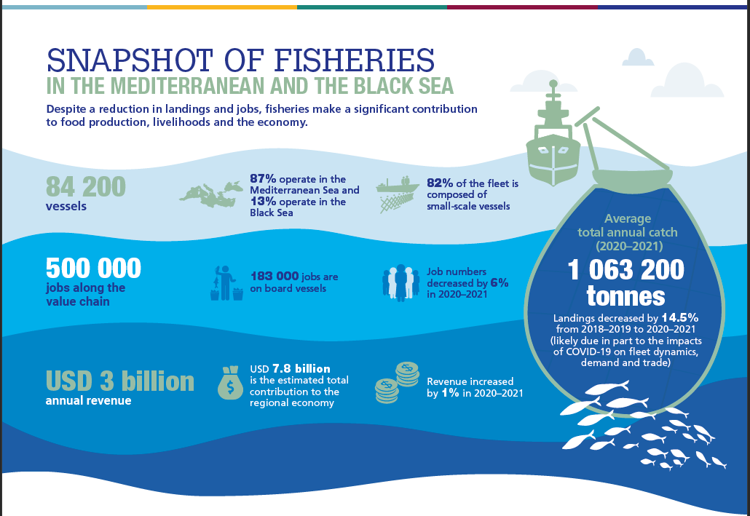
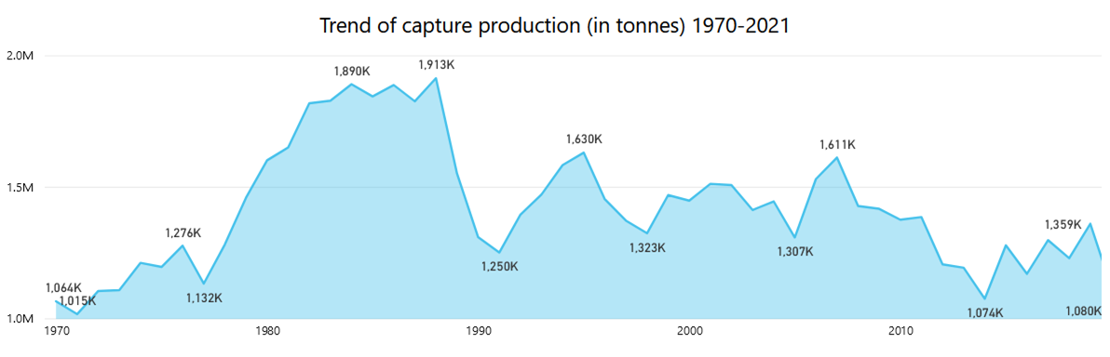
Mediterranean Fishery
Marine capture fisheries in decreasing trend
Small scale fisheries is the majority of fishing vessels
Sustainable stocks are only 20% of total
(SoMFi, 2023)

Slide 5
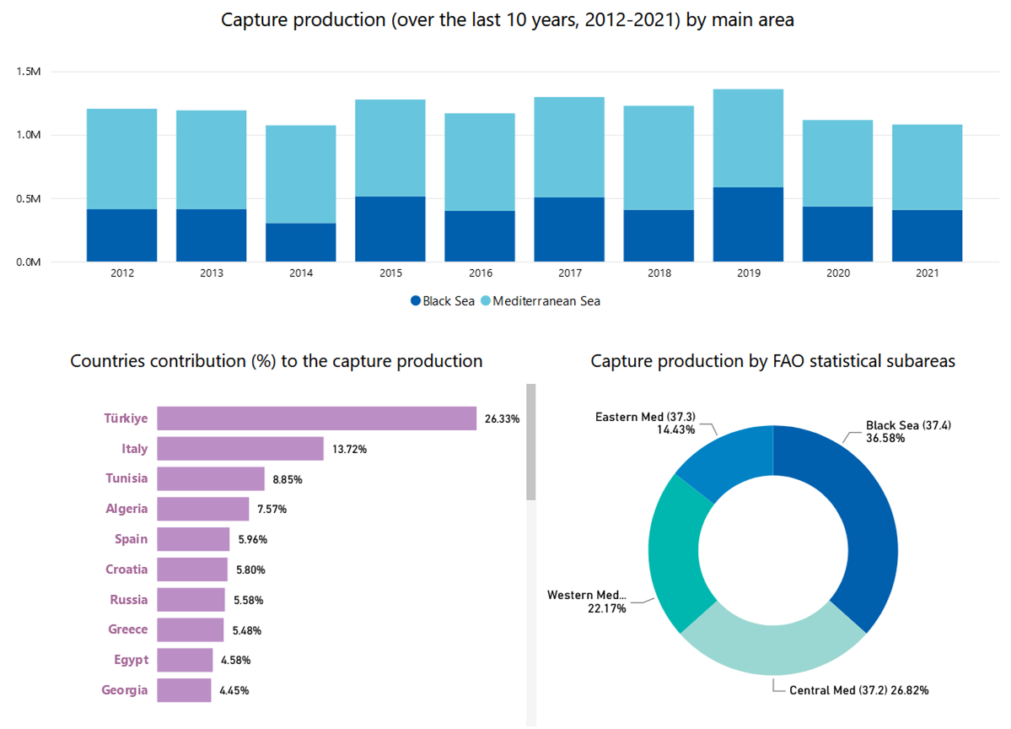
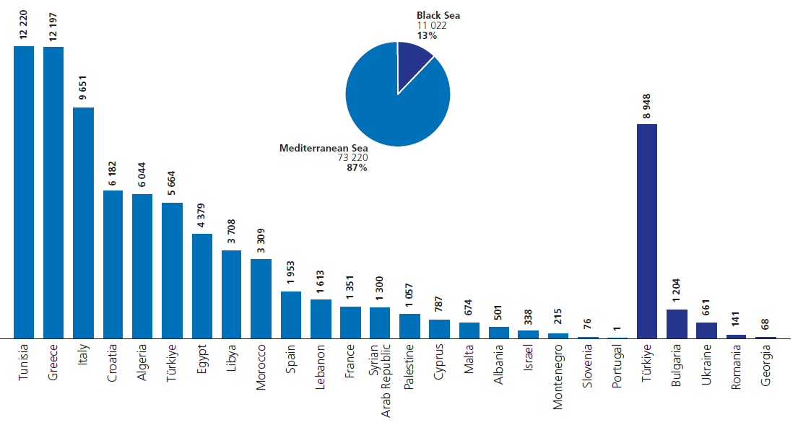
Mediterranean Fishery
Turkey contributes the most with 24.63% of the total
Turkey’s total contribution is ~1.5 Million tonnes
Majority of Turkish fisheries based on Black Sea
(SoMFi, 2023)

Slide 6
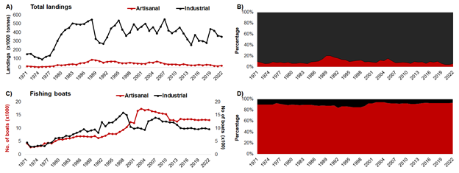
Turkish Fishery
  Majority of the catch from large scale fisheries
  Majority of the vessels from small scale fisheries
(Sea Around US, 2023)

Slide 7
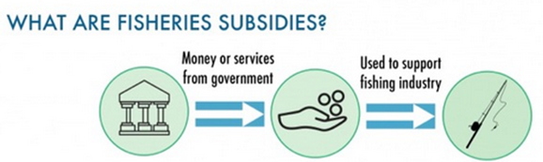
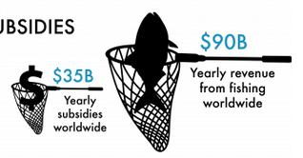
Fishing Subsidies
Direct or indirect financial transfer from public entities to the private fishing sector
Aim: Help the sector make more profit than it would otherwise
Cause: Enhance revenues or reduce fishing costs
Lead:
  Marginal increase in profit
  Participation and fishing effort
(Sumaila et al 2016, Marine Policy)

Slide 8
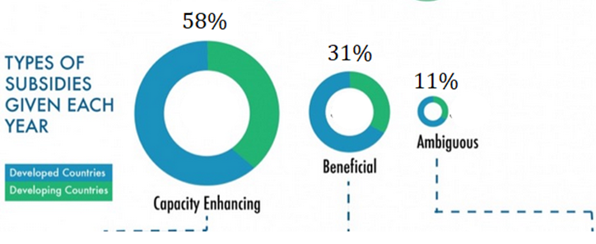
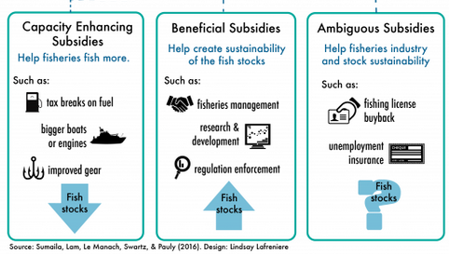
Categorizing Fishing Subsidies
Capacity-enhancing subsidies ►Bad
disinvestments in natural capital assets
also known as “harmful”
Beneficial subsidies ► Good
investment in natural capital assets
Ambiguous subsidies ► Ugly
impacts are undetermined,
either investment or disinvestment

Slide 9
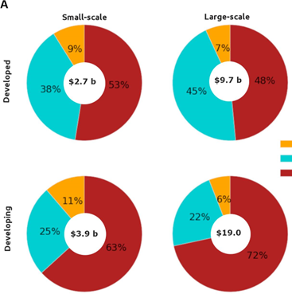
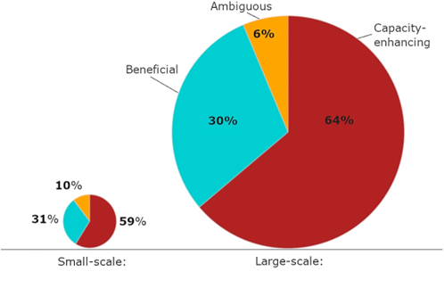
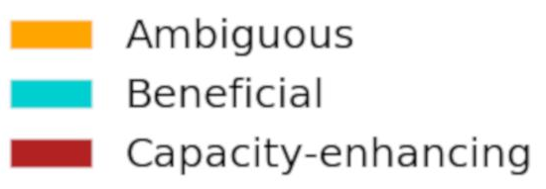
Global Fishing Subsidies
Developed countries = ~ 35%
Developing countries = ~ 65%
Developed SSF = ~ 22% LSF = ~ 78%
Developing SSF = ~ 17% LSF = ~ 83%
~ 19% ~ 71%
(Sumaila et al 2019, Marine Policy)

Slide 10
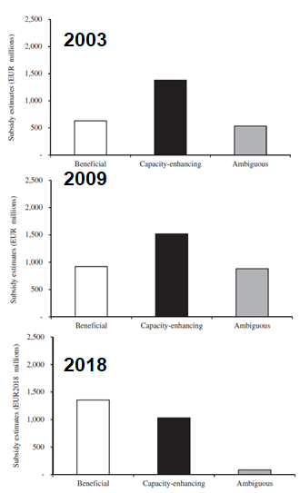
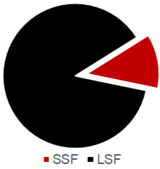
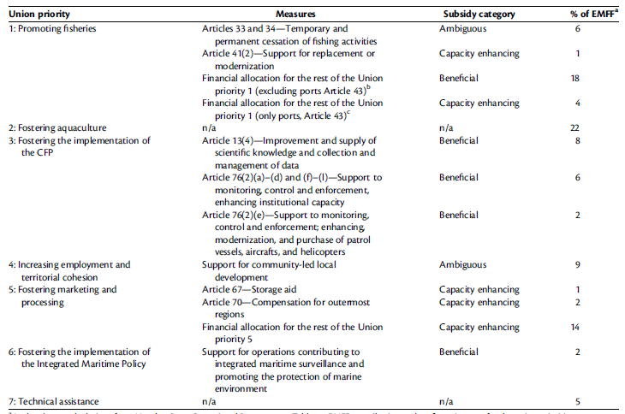
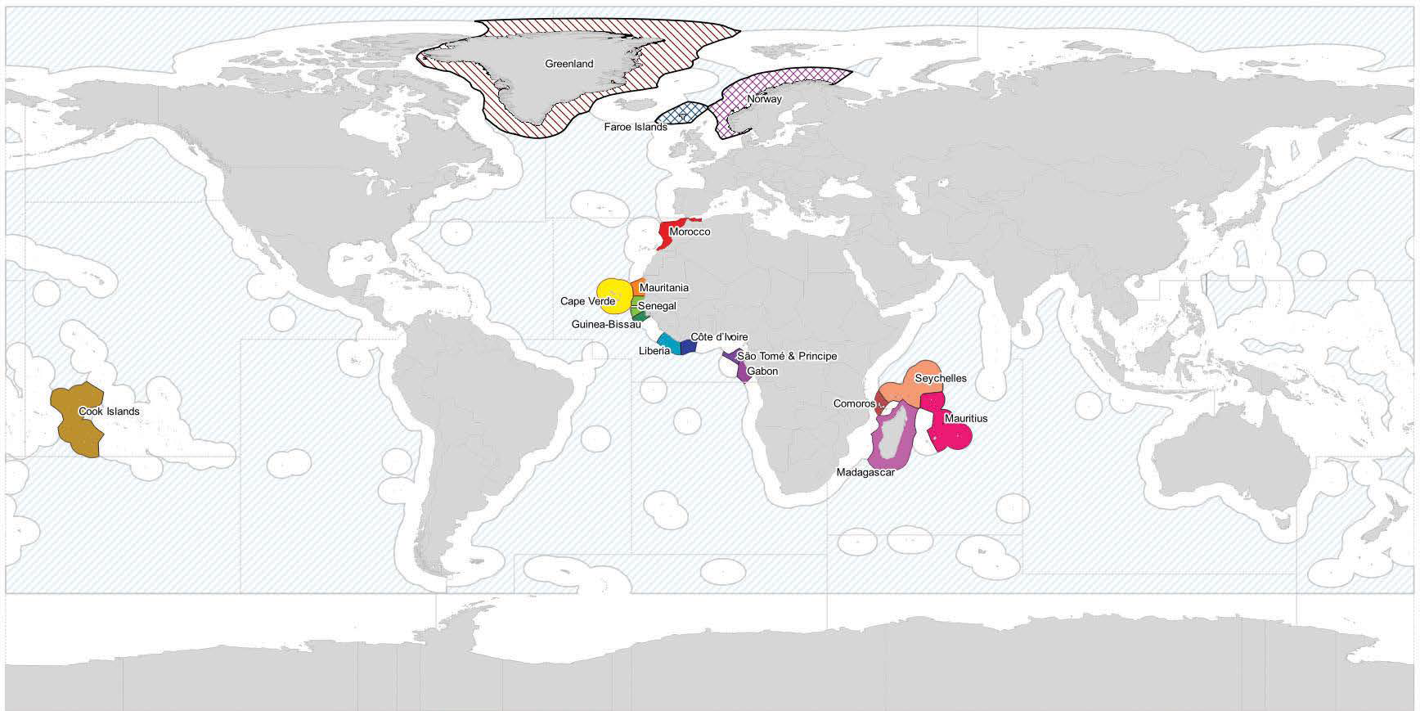
EU Fishing Subsidies
Small scale fisheries is benefited only 20% of total subsidies
A reform after 2013, beneficial subsidies ratio increases
Fishing outside of EU waters is capacity-enhancing
(Skerritt et al. 2020, ICES Journal of Marine Science)

Slide 11
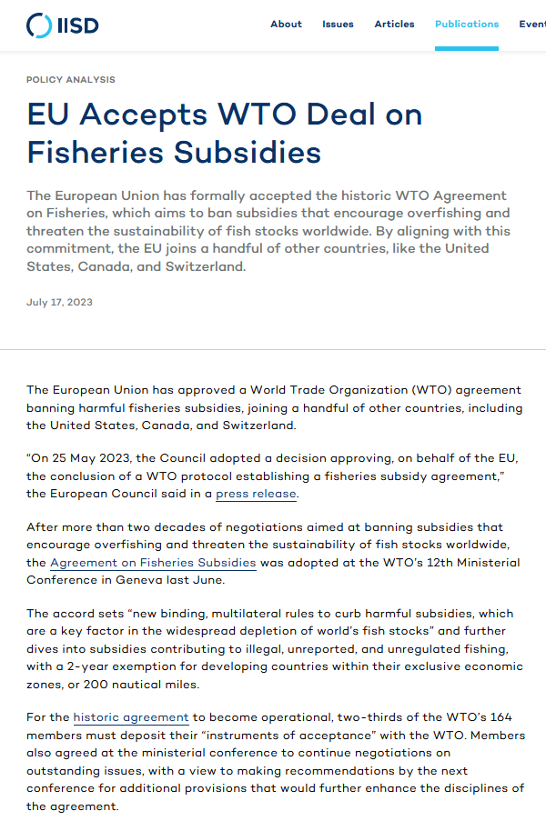
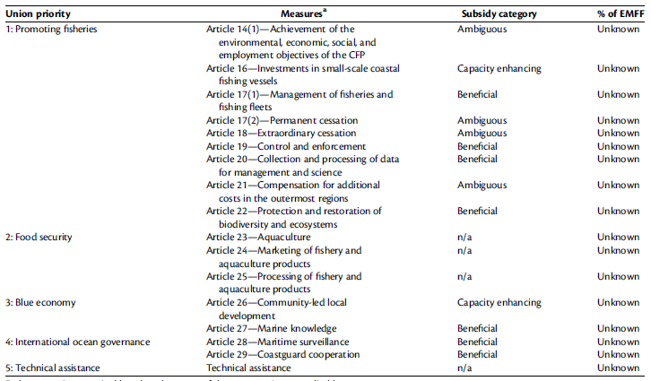
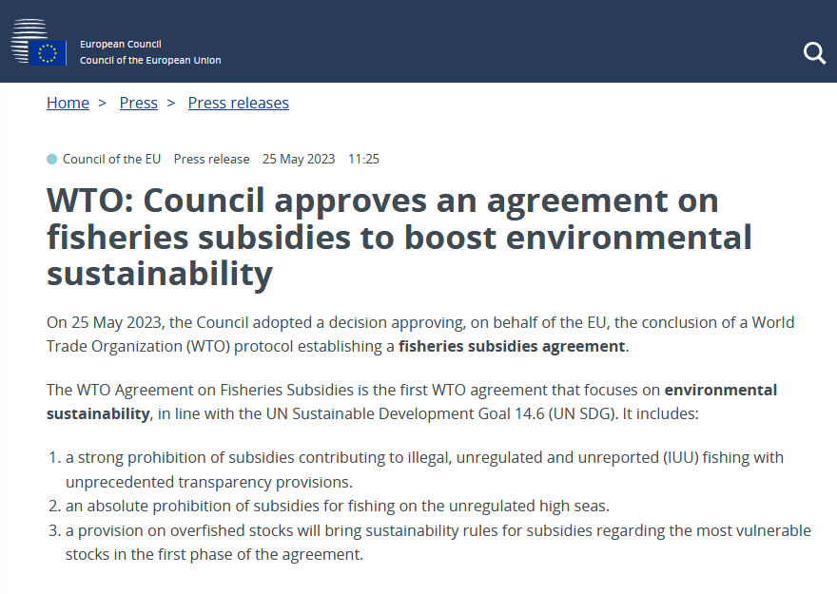
EU Fishing Subsidies
Agreement between WTO and EU Commission in 2023
A great step forward to eliminate harmful subsidies
Beneficial subsidies will greatly increase
Small scale fisheries will be supported
(Skerritt et al. 2020, ICES Journal of Marine Science)

Slide 12
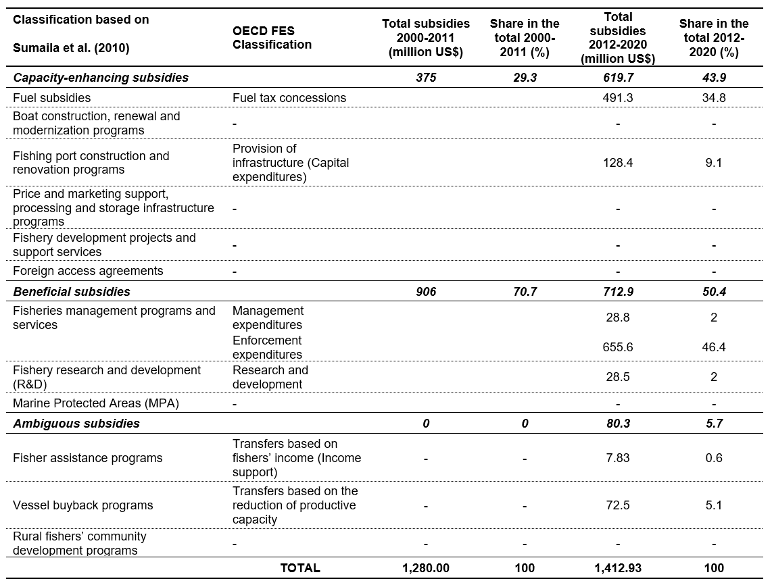
Fishing subsidies in Türkiye
Capacity-enhancing subsidies
  Mainly fuel tax concessions
  Increased its double in the last decade
Beneficial subsidies
  Mainly enforcement expenditures
  Decreased 20 percent in total share
Ambiguous subsidies
  Vessel buy-back programme in 2010s
  Data for the last decade

Slide 13
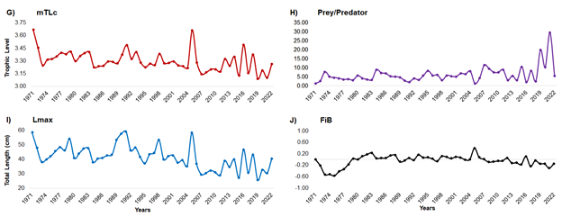
Common Ecological Indices
Decrease ⇘
Mean trophic level
Maximum length
Fishing-in-balance
Increase ⇗
Prey/Predator ratio
withdrawal of larger species
stocks are declining and fishing effort are no longer sustainable

Slide 14
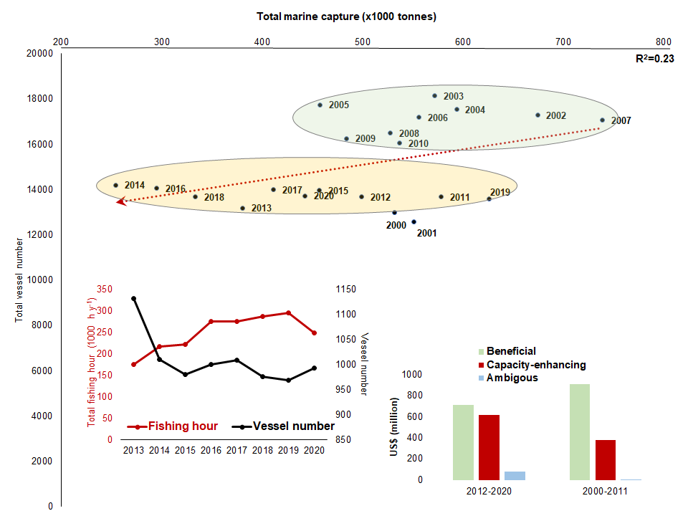
Final remarks
Increase in capacity-enhancing subsidies
Decrease in beneficial subsidies
Ambiguous subsidies:
  2012-2016 vessel buyback programme
Decrease in vessel number
Increase in total fishing hour
Increase fishing effort
Decrease in total catch

Slide 15
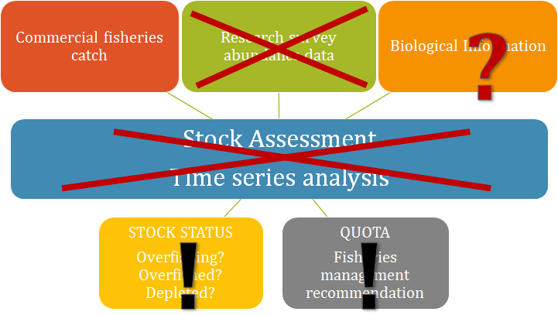
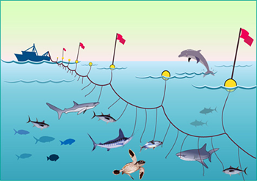
Recommendations
Data availability, and transparency
Improvement in fisheries data
Data availability on monitoring and fishing subsidies
Incentivizing responsible fishing practices
Balancing conservation and economic interests
Well-designed, rights-based, or secure-access fisheries
Revisiting fisheries management policies
Supporting sustainable seafood

Slide 16
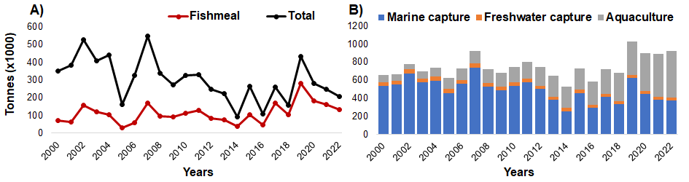
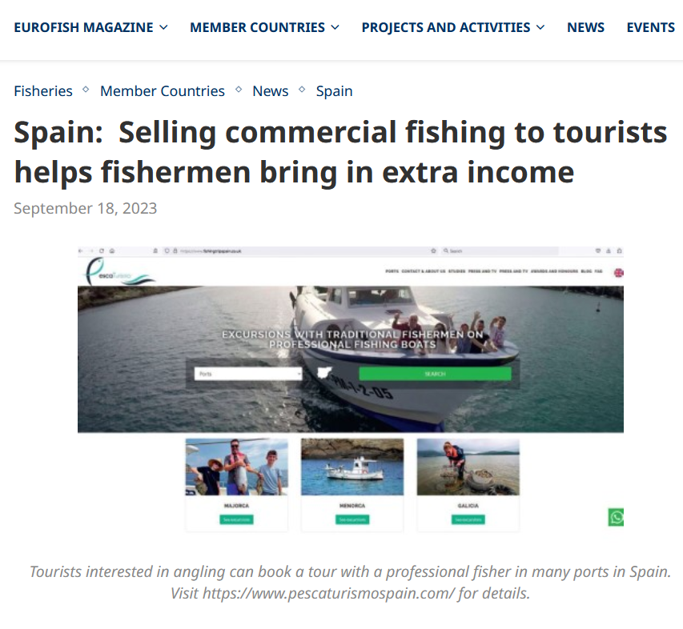
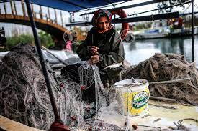
Recommendations
Promoting sustainable aquaculture
Research and innovation for aquaculture feed
Application of quotas on stocks exploited for fish meal
Economic incentives and political support for small-scale fishing activities
Preserving coastal culture and traditional techniques
Socio-economic support of local communities
Supporting friendly practices as “Pescatourism”

Slide 17
Future research directions
Evaluating the Impact of Subsidy Reforms
Long-term ecological and socio-economic impacts
Innovative Financing Models
Exploring new financial models and instruments
payments for ecosystem services
environmental impact bonds
blue carbon credits
Integration of Technology in Fisheries Management
Investigating the role of emerging technologies
artificial intelligence,
blockchain,
satellite monitoring
Cross-Sectoral and Interdisciplinary Approaches
Comparative Studies across Different Geographies
Diverse impacts
ecological and socio-economic contexts
Behavioral and Cultural Dimensions
behavioral responses of fishers and fishing communities
understanding the cultural and social dynamics
  environmentally sustainable
  socially acceptable
  effective
Policy Implementation and Governance Challenges

Slide 18




Thanks for your attention!
ndemirel@istanbul.edu.tr
pinar.ertor@boun.edu.tr
yldztnr@istanbul.edu.tr
Taner Yildiz
Pinar Ertor-Akyazi

